Slide 1



ENHANCING CAPACITES IN IMPLEMENTATION
OF INSTITUTIONAL QUALITY ASSURANCE SYSTEMS
AND TYPOLOGY USING BOLOGNA PROCESS PRINCIPLES:
in two Central Asian regions – Kazakhstan and Uzbekistan (partner countries), with the emphasis on internal quality assurance and institutional typology
Intro: IQAT project & University of Latvia
Part 1: Review on new teaching methods
Part 2: an example of lecture for students «International Business Strategy»
A. Rusakova, Dr.sc.admin.
University of Latvia
Latvian Rectors’ Council
Tashkent, September 5, 2017

Slide 2
  Review on new teaching methods
COURSE DESIGN
6 September 2017

Slide 3
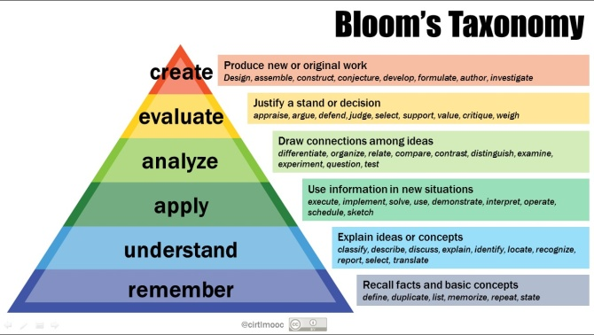
Evaluation&Synthesis (Researcher)
Legislative framework (Rectors’ Conference)
Administrative framework (Study department)
Teaching (lecturer)
Kids (general education)

Slide 4


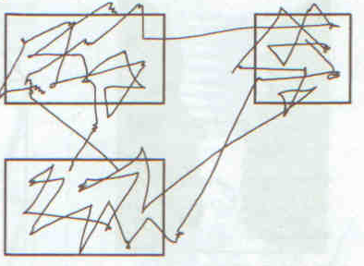
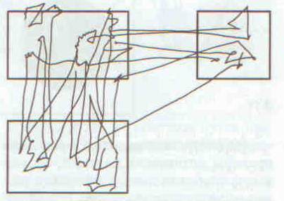
Human “regular” and engineer

Slide 5



Be ready to make mistakes when going international
Studying matters, same as having practical experience
“Self-organizing teams of researchers
(The New Invisible College, C.Wagner, 2008)”
I do not know everything and expect to learn from You too

Slide 6


KNOWLEDGE AND SKILLS FOR LIFE AND WORK IN THE 21ST CENTURY
Communication skills
The ability to learn independently
Ethics and responsibility
Teamwork and flexibility
Thinking skills
Digital skills
Knowledge management
Teamworking skills?
http://www.digitaltrends.com/mobile/best-educational-apps/
John Daniel „Making Sense for Blended Learning: Treasuring an Older Tradition or Finding a Better Future?”

Slide 7
higher-level thinking skills that integrate course content and activities “apply organic synthesis in a environment friendly way”
EFFECTIVE TEACHING
from objectives to outcomes
Methods and learning materials
Evaluation devices
Learning outcomes
Objectives
describe the goals and intentions of the teacher
state the purpose and goals of the course
focus on content
describe what the staff and faculty will do
can often be numerous, specific, and detailed
Outcomes
the evidence that objectives were achieved
describe skills, competencies, and knowledge that students have achieved and can demonstrate upon successfully completing a course
clear and measurable criteria for guiding the teaching, learning, and assessment process
Objectives and content
Intentions of the professor “teach organic synthesis”

Slide 8
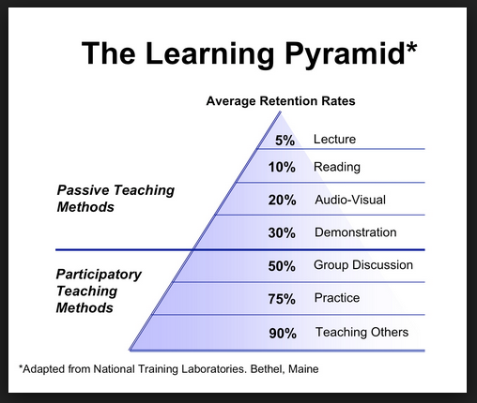
How can we apply this knowledge when designing our course?
Teaching others?
what we learn and remember 2 weeks later

Slide 9
Examples of assignments
Don’t rely on guts only, understand yourself what you want to achieve!
ASSIGNMENT
sell a clearly wrong idea to fellow students
find solution to the problem by providing a list of possible actions
write critical review, using references to theory
teach your colleague student a chapter of theory
read titles of newspaper articles and consider future business opportunities
on basis of some article prepare reports for 2 different target auditoriums
read scientific article and guess 5 keywords, create a title and annotation to an article
case study
OBJECTIVE
scientific polemics
managerial skills
explain and justify own viewpoint in a written form
pedagogic skills
idea generation skills
explain professional issues both to specialists and non-specialists
understand the essentials
evaluate the trustworthiness of the information source

Slide 10
INNOVATIVE PEDAGOGY
What is innovative pedagogy?
What are innovative methods of T&L?
Innovative or effective?
What is desirable for students?
What is possible with curriculum and technology?

Slide 11
T&L STRATEGIES
Effective teachers use an array of teaching strategies because there is no universal approach that suits all situations
Different strategies are used in different combinations with different groups of students to improve their learning outcomes.
Some teaching strategies are better suited to teaching certain skills and fields of knowledge than are others.
Some strategies are better suited to certain student backgrounds, learning styles and abilities.

Slide 12
INNOVATIVE T&L STRATEGIES
Crossover learning
Learning through argumentation
Incidental Learning
Context-based learning
Computational thinking
Learning by doing science
Learning by working
Embodied learning
Adaptive teaching
Analytics of Emotion

Slide 13
T&L Methods
HEURISTIC METHOD
is an approach to problem solving, learning, or discovery that employs a practical method not guaranteed to be optimal or perfect, but sufficient for the immediate goals.
where finding an optimal solution is impossible or impractical, heuristic methods can be used to speed up the process of finding a satisfactory solution
develops problem solving attitude, scientific attitudes towards the problem, and power of self-expression
more: Teoh Sian Hoona, Kor Liew Kee, Parmjit Singh „Learning Mathematics Using Heuristic Approach”

Slide 14
T&L Methods
DISCUSSION/DEBATES
most popular and widely spread method of interactive teaching
increases students’ involvement and activity
Oxford-style debating - a competitive debate format featuring a sharply framed motion that is proposed by one side and opposed by another. Follow a formal structure that begins with audience members casting a pre-debate vote on the motion that is either for, against or undecided. Each panelist presents a seven-minute opening statement, after which the moderator takes questions from the audience with inter-panel challenges. Finally, each panelist delivers a two-minute closing argument, and the audience delivers their second (and final) vote for comparison against the first.
Paris-style debating - format specifically used in France, two teams of five debate on a given motion. One side is supposed to defend the motion while the other must defeat it. The debate is judged on the quality of the arguments, the strength of the rhetoric, the charisma of the speaker, the quality of the humor, the ability to think on one's feet, and teamwork.
more: http://designdebates.nl

Slide 15
T&L Methods
COLLABORATIVE WORK
ensures the students’maximum involvement in the learning proces
students team together to explore a significant question or create a meaningful project
students discussing a lecture
students working together over the Internet on a shared assignment
some researchers, such as Mills and Durden (1992), suggested that gifted students are held back when grouped with weaker students. More researchers support diversity in small groups, however Radencich and McKay (1995) concluded that grouping by ability does not usually benefit overall achievement and can lead to inequalities of achievement.
COOPERATIVE LEARNING
small teams, each with students of different ability levels, use a variety of learning activities to improve their understanding of a subject
increases students’ critical thinking, builds important communication and teamwork skills
Jigsaw Groups - is a grouping strategy in which the members of the class are organized into groups then rearranged in new groups to share their learning.
More: http://www.specialconnections.ku.edu/

Slide 16
International Business Strategy
KVS 1
Collaborative Learning Groups (CLG):
Each CLG consists of 4-5 students from the same seminar group.
Each lecture week you get a few core questions that should help integrating
new knowledge.
Discuss these questions in your CLG.
Evaluate the implications of these questions for your case research project.
Week 1

Slide 17
International Business Strategy
KVS 1
Case Research Project (CLG) OVERVIEW:
We have organised you into heterogeneous groups of 4-5 individuals.
We have designed 8 topics – choose one as a CLG: FIX ON WEDNESDAY.
Conduct your case research and work on the challenge – REPORT (16th October)
APPENDIX of report: Individual reflective essay (max 500 words)
SEMINARS PERIOD II:
Based on your report develop a SEMINAR SESSION (90min).
We expect a high level of creativity and great learning for all.
We expect you come up with a great way to sell your solution.
We expect from the audience in seminars to challenge solutions.
Week 1

Slide 18
International Business Strategy
KVS 1
Due: 16th OCT 2009
Assessment Criteria for Case Research Project:
(1) Demonstration of Skills/capabilities (=40% weight)
(a) Information Literacy (sources; credibility; refs.)
(b) Communication (structure, message, leadership)
(c) Research & Inquiry (formulation of Qs, hyp., methods, etc)
(d) Personal & Intellectual autonomy (your approach)
(e) Ethical, social & professional understanding
(2) Level of Cognitive Understanding (=60% weight)
(a) Display of knowledge & understaning (case; theories; explanations)
(b) Display of application and analysis (how to use your knowledge)
(c) Evidence of evaluation & synthesis (creating new knowledge)
Overall: 35% of final grade (25% is group work/ 10% is individual contribution)
Individual contribution: Each group member adds a personal reflective
essay to the final case research report (up to one page) in the appendix,
stating: (a) what was my contribution?; (b) what have I learned from the
assignment?
Week 1

Slide 19
International Business Strategy
KVS 1
HOMEWORK: ARRANGE A MEETING WITH YOUR CLG (before Wednesday)
SELECT YOUR TOPIC (or decide on the list of preferences)
AGREE ON A REGULAR WEEKLY MEETING TIME
DISCUSS THE OBJECTIVES OF THIS COURSE
DISCUSS WHAT LEARNING THIS CAN DO FOR YOU PERSONALLY
Week 1

Slide 20
T&L Methods
PROBLEM-BASED LEARNING
in problem-based learning (PBL) courses, students work with classmates to solve complex and authentic problems that help develop content knowledge as well as problem-solving, reasoning, communication, and self-assessment skills
Larry D. Spence „Problem Based Learning: Lead to Learn, Learn to Lead”

Slide 21
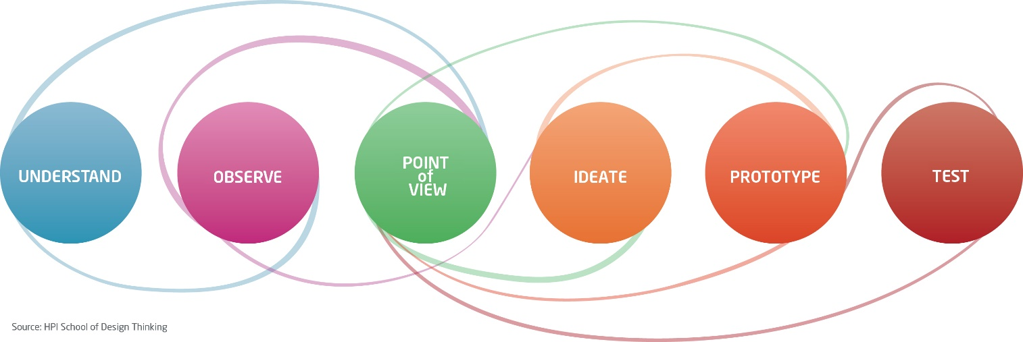
T&L Methods
DESIGN THINKING
Design Thinking is a methodology focused on the end user’s needs
the most important feature of DT is collaboration in interdisciplinary groups.
multistage process of DT consists of: thorough analysis of needs, defining problems and gathering ideas for possible solutions, rapid prototyping (concepts, visualisation, 3D printing)
more: http://dschool.stanford.edu/; http://dt4u.p.lodz.pl

Slide 22
HYBRID (BLENDED) EDUCATION
% Content Delivered Online | Course Type | Definition
0% | Traditional | Course with only face-to-face meetings and no online technology. Content delivered in writing or in person.
1 to 29% | Web-facilitated | Course with primarily face-to-face meetings. May post syllabus, assignments, or resources via a course management system or web pages.
30 to 79% | Hybrid or blended | Course blends online and face-to-face delivery. Much of the content is delivered online, often uses online discussions, and a reduced number of face-to-face meetings.
80% or more | Online | Course with most or all content delivered online. No face-to-face meetings.
I. Elaine Allen and Jeff Seaman “Learning on Demand: Online Education in the United States, 2009”

Slide 23
T&L Methods
CASE STUDY
cases are discussed with the students and they study the issue thorougly
the essence is a collective analysis of a situation, finding a solution and a public defence of said solution
ROLE-PLAYING GAMES AND SIMULATIONS
games played according to previously prepared scenario enable students to estimate the problem from different standpoints
often used as ice breakers with new groups
TRAINING
training aims at developing skills and knowledge in any field by performing sequential tasks, activities or games.

Slide 24
Applying basic quality tools in problem based learning – case study

Slide 25
PROBLEM
defining problem
analyzing/grouping all possible causes of the problem
selecting the most probable cause/causes
suggesting at least as many solutions to the problem as many causes were found
examining proposed solutions for threats

Slide 26
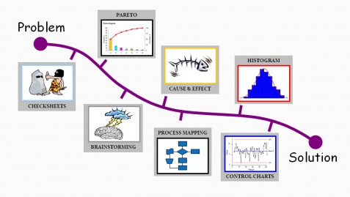
shows on a bar graph which factors are more significant
identifies many possible causes for an effect or problem and sorts ideas into useful categories.
graphic representation of collected data - allows simple visual analysis of that data
structured, prepared form for collecting and analyzing data
group technique to stimulate creative thinking, either to discover potential causes of a problem or potential solutions
simple method to highlight wasteful steps in your processes
process monitoring tool

Slide 27
CONCLUSIONS
Effective teaching demands making difficult choices, exercising careful judgment, and honouring the complex nature of the educational process.
The primary mission of teaching is to foster the development of skills, dispositions, and understanding, while accepting a wide range of students’ needs and increasing diversity of student body.
Teachers have to challenge existing structures, practices, and definitions of knowledge, to apply, invent and test new approaches, and to follow up organizational change.

Slide 28
International Business Strategy
Agnese Rusakova

Slide 29
I have a nice product.
Do I?
BUSINESS
INTERNATIONAL
I have a nice product.
Do You think it could be sold internationally?
I have a nice product.
Do You think it could sell in China?
STRATEGY

Slide 30


Slide 31
International Business Strategy
International Business
What is that?
Macro
Environment
Industry
Organisation
Function
Manager/E
Processes
Issues
ISSUES
I N T E R A C T I O N S
VIEWPOINTS
PHENOMENON
SOLUTIONS
Economics, political science, sociology, social
psychology, management, marketing, finance
accounting, etc.
good STRATEGIST needs
…a bit of behavioural knowledge;
…a bit of dynamic capabilities;
…understanding of relationships;
…a sense of environmental implications
I N T E G R A T I O N S
Zettinig & Vincze, 2008
Week 1

Slide 32
Limitations of human’s cognitive abilities
Limited information sensing ability
Limited information processing ability (use of mental short-cuts, number of key variables e.g. cognitive heuristics (Janis, 1989))
Limited information storage capacity - cognitive maps (McCaskey, 1982), construed reality (Finkelstein, Hambrick, 1996)
Cognitive rigidity - people tend to significantly overestimate the value of information that confirms their cognitive maps and seek out evidence that supports their beliefs (Schwenk, 1984)
Cognitive maps constructed through interaction – shared reality (Daft and Weick, 1984), group’s dominant logics (Prahalad and Bettis, 1986), belief system (Noorderhaven, 1995), which can be shared by any group (e.g. family, firm, industry, nation

Slide 33
Introduce yourself
Please choose 3 concepts to describe yourself.
Be creative.
What defines you as a person?
What is important in your life?
What do you aspire to in future?
Identity; intended identity, construed image; reputation
(Dacin et al. 2006)
Strategy is: contextual, idiosyncratic

Slide 34
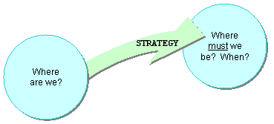
What defines you as a person?
What is important in your life?
What do you aspire to in future?
What is important in your life?
So..what is Your strategy to combine the two?
What do you aspire to in future?

Slide 35
What are the goals of the firm?

Slide 36
What are the goals of the firm?
A complex mix of stakeholders-derived goals and demands on the firm….
…further complicated by institutional environments

Slide 37
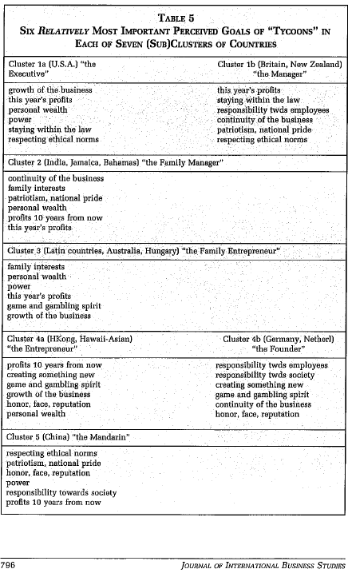
What implications
do you see in this?
Hofstede et al., 2002
Strategy is: contextual, idiosyncratic

Slide 38
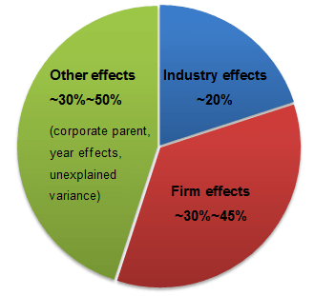
Focus of this course
The ‘firm’ is successful because it has the will to succeed and because it makes good decisions?
The ‘environment’ shapes the firm? If the environment is right the ‘firm’ will be successful?
What determines the international success and failure of the firm?
Firm Resources and Sustained Competitive Advantage (Barney, 1991)

Slide 39
about me about course
Bachelor of International Economic Relations

Slide 40
about me about course
Bachelor of International Economic Relations
1.Business opportunities

Slide 41
part 1
1.Business opportunities
See the business around you and processes as possible businesses
See the whole picture, don’t rely on facts without further questioning
See that each setting and business environment next to risks provides business opportunities
I have a nice product.
Do I?

Slide 42
Company
What can you tell about the company and its products?
Local company
Almost 100 years old
Market share: 17% of clients
Annual turnover: 65.4 millions EUR
Pool of current clients: 12 060, average project lenght per client: 3,1 years
Employees: 3250 (7% administration), incl. 33 foreign specialists
See the business around you and processes as possible businesses

Slide 43

The Production System specifics: University of Latvia
SYSTEM | INPUT | RESOURCES | TRANSFORMATION FUNCTION | OUTPUT
Higher education institution | Graduate of secondary education | Lecturers, rooms, books | Transfer of knowledge and experience | Graduate
See the business around you and processes as possible businesses

Slide 44
One of 62 HEI in Latvia
Public university
Public HE funding has not decreased in 2014
Rector is well paid: 87 000 EUR per annum
Professors are very well paid
State funds study placements
See the whole picture, don’t rely on facts without further questioning

Slide 45
some history..
One of 62 HEI in Latvia?
change from communism to capitalism
elite -> mass -> universal [higher education] (Brennan, 2004)
Globalisation is forcing change across all knowledge-intensive industries, creating a ‘single world market’. The ‘battle for brainpower’ complements traditional struggles for natural resources. Global rankings measure the knowledge-producing capacity & talent-attractiveness of HEIs
universal HE – adoption of “whole population” to rapid social and technological change
  Lower criteria for becoming student
  Lower study standards
  Less outlooks for work and career
  Problems with funding (public vs. private good?)
  Because of more and diverse student set, diverse HEI needed
NB! Mass HE in Latvia is set as a target by government -> Main indicator for HE in NAP of LV – in 2020 the ratio of 30-34 year olds with HE - 40%.

Slide 46
Annual turnover: 65.4 millions EUR
Pool of current clients: 17 060, average project lenght per client: 3,1 years
Employees: 3250 (7% administration), incl. 33 foreign specialists
Monogrāfijas
Optically polarized atoms: understanding light-atom interactions
Marcis Auzinsh, Dmitry Budker, and Simon M. Rochester
Oxford University Press, 2010, 380 pages
(ISBN-10: 0199565120; ISBN-13: 978-0199565122
Optical Polarization of Molecules
Marcis Auzinsh, Ruvin Ferber
Cambridge University Press, 2005 (first edition 1995), 322 pages
(ISBN-10: 0521673445 | ISBN-13: 9780521673440)
Is the Rector well paid?
Redaktors | Centrāleiropas Fizikas Žurnāls | Vācija, heidelberga, Tiergartenstrase 17
Nanosize materials for photonics and optoelectronics based on a alkali metal vapour. European Regional Development Foundation (2006–2008). Contract number VPD1/ERAF/CFLA/05/APK/2.5.1./00035/018. Projekta vadītājs Prof. Marcis Auzinsh.
Novel magntic sensors and techniques for security applications. NATO Science for Peace projects, Ref. No. CBP.MD.SFP 983932. Projekta vadītājs Prof. Marcis Auzinsh (2011–2013)
ES 7. Ietvarprogrammas projekts COLIMA - Coherent manipulation of light and matter via interferences of laser-dressed states. Projekta vadītājs Prof. Mārcis Auziņš (2011 – 2013)

Slide 47
Nr. p.k | Pedagoga amata (profesijas) nosaukums | Zemākā mēneša darba algas likme (euro)
1. | Rektors | 1410,07
2. | Profesors | 1175,29
3. | Prorektors | 940,52
4. | Asociētais profesors | 940,52
5. | Dekāns | 940,52
6. | Docents | 752,70
7. | Katedras vadītājs | 752,70
8. | Prodekāns | 601,87
9. | Lektors | 601,87
10. | Asistents | 480,93
2015./2016.mācību gadā skolotāji varētu saņemt 709 eiro algu
LETA | 27. augusts 2014 15:42
Are the Professors very well paid?
NB! The minimal wage in Latvia has grown by 12,5%, from 285 EUR to 320 EUR as of 2014. The average wage in Latvia is 742 EUR (2014).
Ministru kabineta noteikumi Nr.836
Rīgā 2009.gada 28.jūlijā (prot. Nr.50 64.§)
Pedagogu darba samaksas noteikumi
See the whole picture, don’t rely on facts without further questioning

Slide 48
One of 62 HEI in Latvia: 17 public HEI, colleges included, one of leading countries in world by student numbers
Public university: 17% of funding is public
Public HE funding stays the same in 2014: decreases
Rector is well paid: private income added
Professors are well paid: depends..
State funds study placement: the 30% of study placements are funded up to only 70%
ValstsKase
See the whole picture, don’t rely on facts without further questioning

Slide 49
Quiz
Public HEI’s vs. Private HEI’s
Which is larger:
Latvia University of Agriculture or Turiba?
Daugavpils University or Baltic International Academy?

Slide 50
Quiz
Public HEI’s vs. Private HEI’s
Latvia University of Agriculture larger than Turiba
[5142 students (2011)] [4826 students (2011)]
Daugavpils University smaller than Baltic International Academy
[2760 students (2011)] [3202 students (2011)]

Slide 51
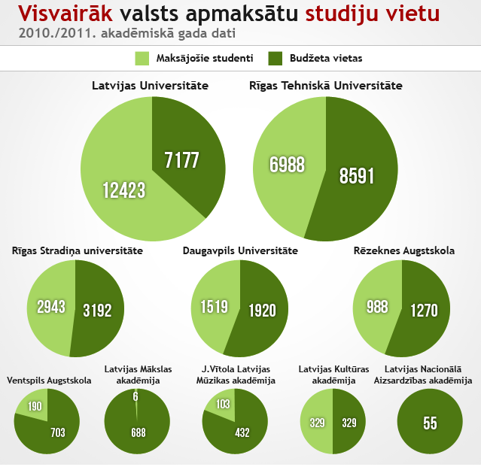
Speaking about public and private HEI, which one is public university in Latvia?

Slide 52
Quiz
Public HEI’s vs. Private HEI’s
Funding of which university will suffer more:
Change of government politics towards less public funding
Change of government politics towards more public funding
Economic crisis
Due to Russia embargo less money available for Ministry of Agriculture and more for Ministry of Defence
Allowing public universities to teach in Russian
Accessibility of study loans increases
Latvia has a dual HE funding mechanism

Slide 53
Calculating according to the existing trend the student numbers at the University of Latvia will decrease by 40 % in the next 4 years
Are there problems with quality?
How to measure the quality?
What is quality education?
See the whole picture, don’t rely on facts without further questioning

Slide 54
Quality concepts (Harvey, Green 1993)
Can they be used as substitutes?
Quality as excellence
Quality as “zero mistakes”
Quality as “conformity to the aim”
Quality as “minimal standards”
Quality as transformation
Quality as accountability
Quality as continuous improvement
quality perception over time
quality perception as mindset
quality perception in relation to extent/degree of focus
quality perception in relation to a set of criteria
stakeholder issue
quality vs. perceived quality

Slide 55
Some fallacies to awoid
Preferences of individuals change, sometimes drastically over time (Miles and Cameron, 1982)
What people say they prefer and what their behaviour suggests they prefer is not always the same (Argyis and Schon, 1978)
Contradictory preferences are held by individuals and pursuied by organizations suimultaneously, it is not unusual for individuals in organizations to prefer both growth and stability, efficiency and flexibility, high capital investment and high returns to atakeholders, autonomy and control (Cyert and March, 1963)
Consensus regarding the best, or sufficient, set of indicators of effectiveness is impossible to obtain. Criteria are based on the values and preferences of individuals, and no specifiable construct boundaries exist. Constructs are mental abstractions used by individuals to interpret their own reality(Cameron, 1986)
Using proxies: when individuals find it difficult to judge a product on the basis of “primary” criteria (e.g. how well soap gets out dirt) they will not postpone judging the product. They will make a selection on the basis of secondary or tertiary criteria that are easy to detect (e.g. colour of the box) (Whetten, 1981)

Slide 56
Mana nemainīga pārliecība ir, ka valstij un Latvijas nodokļu maksātājiem nav jāfinansē nekvalitatīvas studiju programmas vai tādas, kam konstatēti nozīmīgi trūkumi.
Lai kopējā izglītības kvalitāte pieaugtu, nekvalitatīvajām programmām paredzētais finansējums jānovirza kvalitatīvām studiju programmām, kādu mums ir vismaz 400.
Summējot, augstskolu darbības rezultāts, izglītības kvalitāte būtu jāvērtē saskaņā ar speciālistu sagatavotības līmeni.
Kā liecina prestižākā jeb tā sauktā QS reitinga jaunākie rezultāti, kas kļuva pieejami septembra vidū, Tartu Universitāte ir pirmajā piecsimtniekā. Mēs esam kādi tūkstošie.
Augstākās izglītības iestādes, savu egoistisko interešu vadītas, pretojas IZM piedāvātajām reformām.
IKNS līdztekus ārējai kvalitātes nodrošināšanas sistēmai (akreditācijai) ir viens no galvenajiem augstākās izglītības kvalitātes balstiem.
Sabiedrība augstākai izglītībai ir izvirzījusi un turpina izvirzīt arvien jaunus, dažkārt konfliktējošus un pārāk lielus mērķus cerot, ka augstākā izglītība kā tāda varēs atrisināt: ekonomiskās izaugsmes, darba vietu trūkuma, inovāciju, sociālā taisnīguma un neveiksmīgas publiskās pārvaldes problēmas.
Which excerpt corressponds to which quality concept?
Quality as excellence
Quality as “zero mistakes”
Quality as “conformity to the aim”
Quality as “minimal standards”
Quality as transformation
Quality as accountability
Quality as continuous improvement

Slide 57
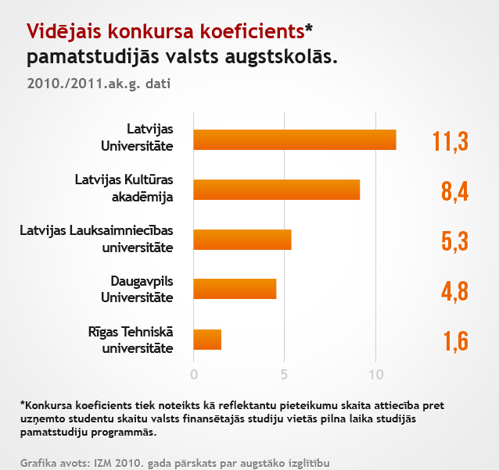
Does this criteria says anything about the quality of the institution?

Slide 58
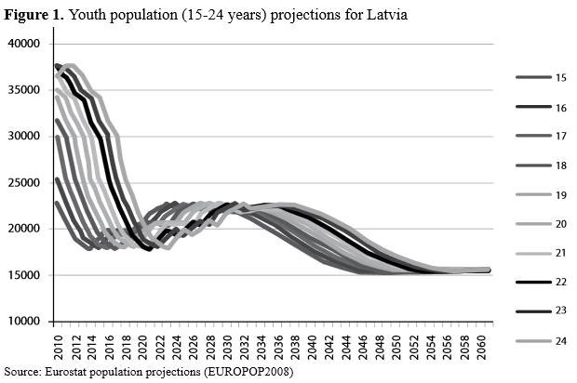
Calculating according to the existing trend the student numbers at the University of Latvia will decrease by 40 % in the next 4 years

Slide 59

ACADEMIC CENTRE IN TORNAKALNS (by 2020)
Projekta vizualizācija Nr. 1
Is it efficient to have such extensive building with student numbers dropping?

Slide 60


Latvijas Universitātes Akadēmiskais centrs – 2020. gads
Concentration of faculties in one place improves property governance by more than 2x decreasing the used area per student from the current 17.75m² to7.6m²
Students in Tornakalns
12700
17.75m²
7.6m²
...................................................................................
Dzīvības un veselības zinātņu akadēmiskais centrs
Dabaszinātņu akadēmiskais centrs
Humanitāro zinātņu akadēmiskais centrs
Sociālo zinātņu akadēmiskais centrs
Skolotāju izglītības centrs
Studiju servisa, ēdnīcas, rekreācijas centrs
Dienesta viesnīcas
Sporta centrs
Ekumeniskā baznīca

Slide 61
Anyways, where to get the students from?

Slide 62
European Higher Education Area (EHEA)
Are we able to compete and attract tuition fee paying students
(local, from EU, from 3rd countries)?
Denmark
University education in Denmark is free.
Finland
No tuition fees are charged for Bachelor’s and Doctoral programmes, regardless of your nationality.
France
Public universities charge only between about EUR 200 and EUR 650 EUR per year depending on study level (Bachelor’s/Master's) and study programme.
Germany
Universities are allowed to charge a maximum of 1000€ a year but in the academic year 2013/2014 most universities do not charge any tuition fee.
Norway
Higher education in Norway is considered to be free of charge for everyone, although in state universities students have to pay for a small semester fee of EUR 39.00-79.00 approx.). Students are granted a student card that gives them the right to have health care and transport for free, as well as reductions for cultural activities and events.
The Netherlands
In The Netherlands study fees for EU students are EUR 1,835 Euro (2013/2014) .

Slide 63
European Higher Education Area (EHEA)
Are we able to compete and attract tuition fee paying students
(local, from EU, from 3rd countries)?
Estonia
Starting from the autumn 2013 admission, all Estonian-taught degree programmes are free of charge for full-time students.
Spain
In public universities those cost between EUR 535 and EUR 1,280 per academic year.
Sweden
Free.
Switzerland
For EU-EEA members study fees in Swiss universities range between 750-3000 EUR. Scholarships are available for EU and eastern European students.
Italy
In public universities an annual fee ranges between EUR 150 and EUR 3,500, depending (on your family income and) on the university chosen.
UK
After offering low tuition fees for long time (no tuitions were paid until 1998), the UK government has recently decided to allow universities to raise study fees. It is important to note, that Scotland, Wales and Northern Ireland are independent from this decision and pursue their own strategy on tuition fees. In Scotland for example, Scottish and non-UK EU citizens do not have to pay any tuition fee. For EU residents and EEA/Switzerland students tuition fees range from £ 3,500 (EUR 4,255 approx.) up to a max of £ 9,000 (EUR 10,941 approx.) per year.

Slide 64
Let’s consider the Company’s quality..
Quality as excellence
Quality perception in relation to a set of criteria
namely
University’s of Latvia
position in RANKINGS
additional criteria: national vs. international scale

Slide 65
Benchmarking Company
Nr. 1 in Latvia
Webometrics ranking: in 2012 in world 1327
QS Top Universities: 701-800
GreenMetric ranking: in 2012 among urban and comprehensive universities 149
Interfax ranking CIS, Baltics, Georgia: 54
See that each setting and business environment next to risks provides business opportunities

Slide 66
Benchmarking Company
Nr. 1 in Latvia [largest market share in Latvia: 17%]
Webometrics ranking: in 2012 in world 1327 [next best from LV-RTU=2255]
QS Top Universities: 701-800 [the only HEI from LV]
GreenMetric ranking: in 2012 among urban and comprehensive universities 149
Interfax ranking CIS, Baltics, Georgia: 54
Multiranking
See that each setting and business environment next to risks provides business opportunities

Slide 67
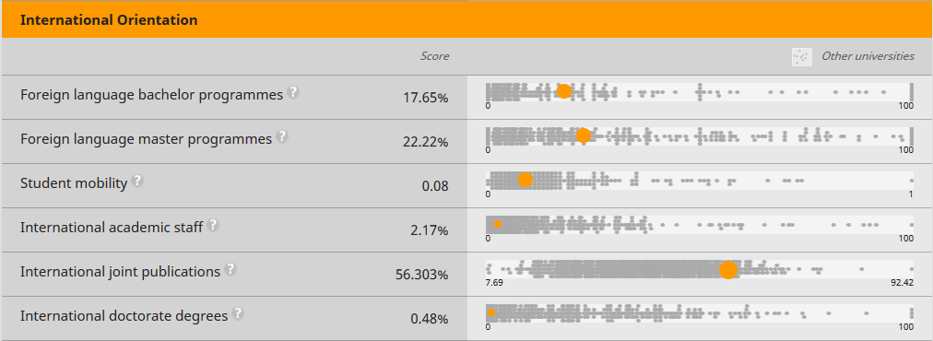
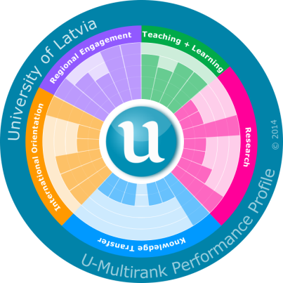

Multirank: diversity of HEI is good
University of Latvia ranked by its international orientation (2014)

Slide 68
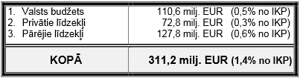
QS Top Universities: 701-800
701+
from 22 000 HEIs listed
top 3,5% in the world (NB! Tartu University – top 3%)
Compare
University of Latvia (17 000 students; QS Top-700-800) 65 mio EUR turnover
University of Tartu (17 000 students; QS Top -460-470) 146 mio EUR
Humboldt-Universität zu Berlin (17 000 students; QS Top-126) 340 mio EUR
Total public higher education funding in Latvia = 110 mio EUR (with EU Structural Funds; 60 mio EUR without EU SF)
Is there a correlation between available funding to the HE and the quality?

Slide 69
Perceived quality
Would your perceived quality of the studies at the University of Latvia be influenced by the fact that the studies ..
  cost 20 000 EUR per year
  are totally free
  6000 EUR per year, some benefits
  cost 100 EUR per year, but public transport then is for free
  cost 100 EUR per year, but allow free parking everywhere in Riga center
  742 EUR per year
  1500 EUR per year, 30% reduction on public transportation costs
  are for free as long as you do not have to pay for them on merit basis, 1500 EUR otherwise

Slide 70
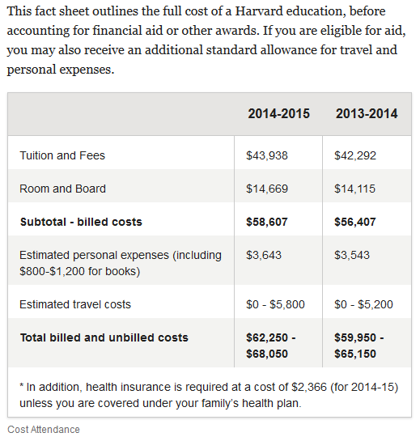
What are the job prospectives of Harward graduate?
Please describe the profile of the student, that can afford studying one year in Harvard.

Slide 71
Consider..
Which market would consider us attractive enough to pay tuition fees?
Which countries are our closest competitors on those markets?
Is it possible to export to that country or we shall have a franchise?
What is our competitive advantage when compared to those countries?

Slide 72
Core content: part 1
What is internationalization and business globalization?
What is International Business? Ways of International Business (Affiliated undertaking, joint venture, franchising, offshore production, export, import).
What is competitive advantage? Types of competitive advantages: internal and external, tactic and strategic, natural and artificial, high level and low level. Life cycle of the competitive advantage and life cycle theory of the product.

Slide 73
about me about course
Bachelor of International Economic Relations
M.sc. Multimedia Management
Business opportunities

Slide 74
about me about course
Bachelor of International Economic Relations
M.sc. Multimedia Management
Business opportunities
2.Environment: consumer

Slide 75
part 2
Environment: consumer
Apply the basics of consumer perception to create the product/service
See what is common to all global customers and what is the difference among customers globally
See the consequences of the decision
I have a nice product.
Do You think it could be sold internationally?

Slide 76
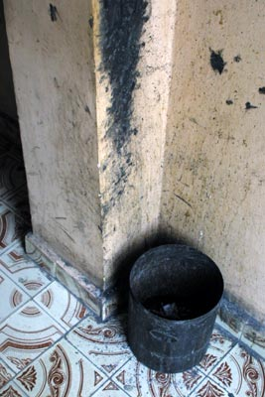

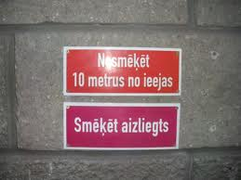
Apply the basics of consumer perception to create the product/service

Slide 77
How will be the Company perceived?
The only university from Latvia ranked in QS Top Universities
The only university from Latvia ranked in QS Top Universities
The only university from Latvia ranked in QS Top Universities
The only university from Latvia ranked in QS Top Universities
Apply the basics of consumer perception to create the product/service

Slide 78
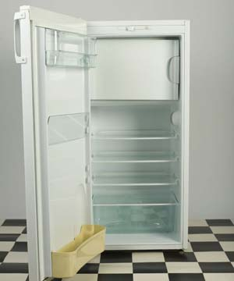
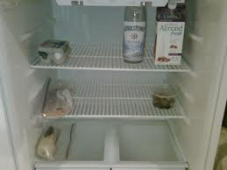
To what extent are the
customers the same around the globe?

Slide 79
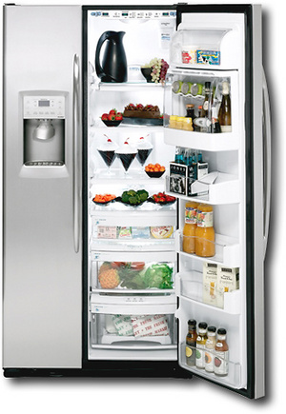

To what extent are the
customers the same around the globe?

Slide 80
How will be the Company perceived?
The only university from Latvia ranked in QS Top Universities
It is not ranked in any of worlds most influential HEI rankings (Shanghai, THE, QS)
  Ranked among Top 3,5% universities in the world
To what extent are the
customers the same around the globe?

Slide 81
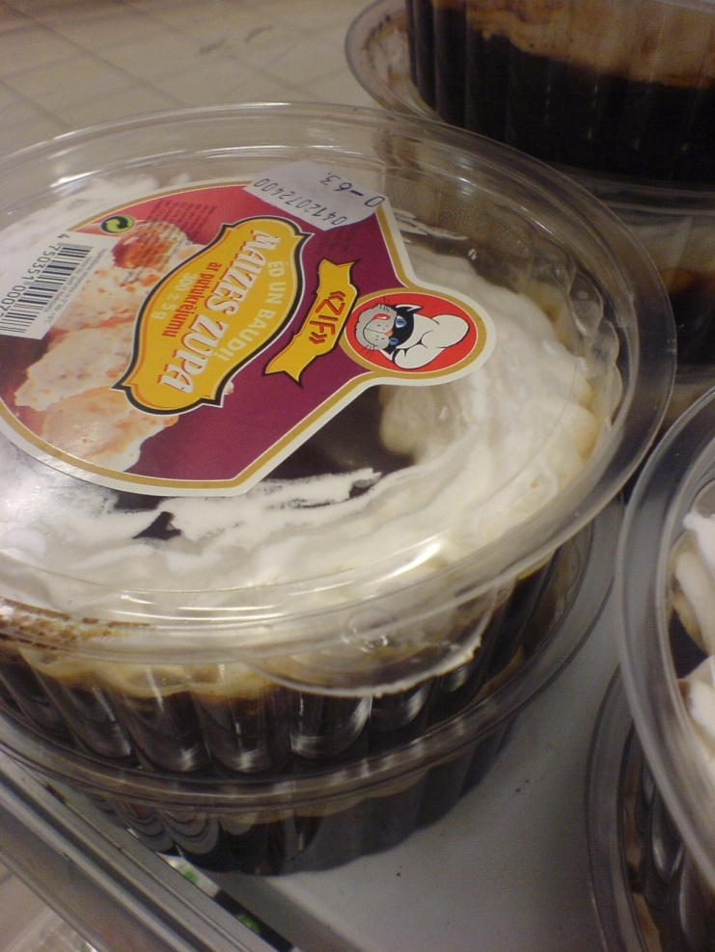
See the consequences of decision

Slide 82
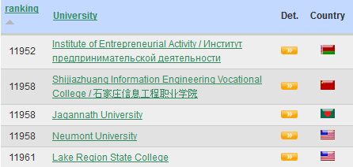
How will be the Company perceived?
Ranked badly
Not ranked at all
                webometrics* 2014
when communicated as..
  Ranked QS Top Universities: 701-800
  Ranked QS Top Universities: 701+
  Ranked QS Top Universities: 701-800 among 22 000 listed
  Ranked among Top 3,5% universities in the world
  The only university from Latvia ranked in QS Top Universities
See the consequences of decision

Slide 83
Core content: part 2
Consumer Behaviour. Basics of human perception. Impact of environmental stimuli (e.g. culture, demographic etc.) on human perception of the product. Black box model. Global consumer trends.
Consumer perception of the product and its constituents. Changing the environment and product setting in order to make the product attractive.

Slide 84
about me about course
Bachelor of International Economic Relations
M.sc. Multimedia Management
Dr.sc.admin. in Educational Management
Business opportunities
Environment: consumer

Slide 85
about me about course
Bachelor of International Economic Relations
M.sc. Multimedia Management
Dr.sc.admin. in Educational Management
Business opportunities
Environment: consumer
3. Resources and tools

Slide 86
part 3
What is the aim?
What are the resources?
Which strategy to choose?
Which tools to use?
I have a nice product.
Do You think it could sell in China?

Slide 87
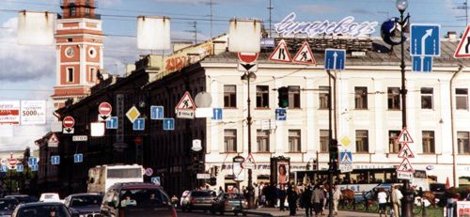
Which lane to choose to get straight ahead from here?
Environment is complex
Knowing the environment’s main features helps evading most common mistakes

Slide 88
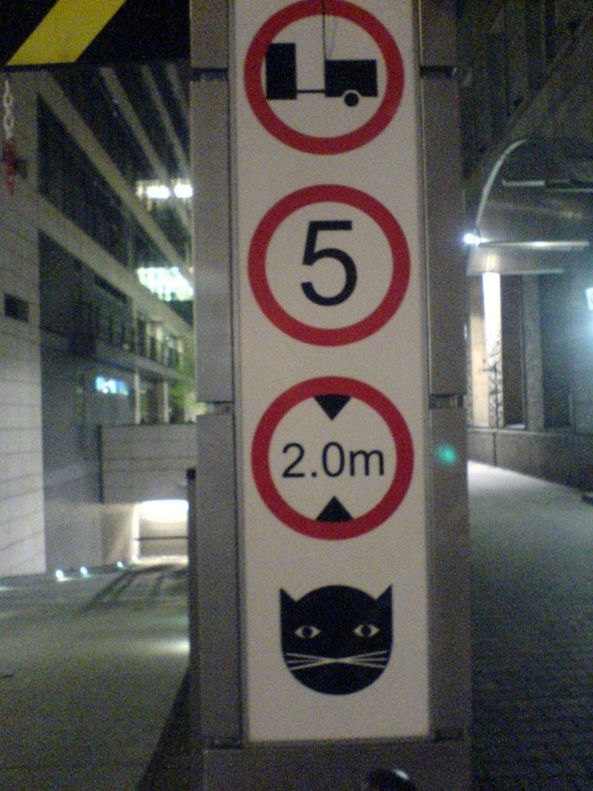
Is it important to know theory? Can we rely on theory alone?
Tools are necessary for categorizing and thus simplifying the environment = theory!
Each theory involves limitations, because it simplifies

Slide 89
International Business Strategy
KVS 1
WHAT Business Leaders & Strategists do (Buckley, Lassard 2005)
Observation
Theory Issues
Driven Generalisation Hypotheses Driven
Testing

Slide 90
Benchmarking Company
Nr. 1 in Latvia
Webometrics ranking: in 2012 in world 1327
QS Top Universities: 701-800
GreenMetric ranking: in 2012 among urban and comprehensive universities 149
Interfax ranking CIS, Baltics, Georgia: 54
What does the position in the ranking tells about the University of Latvia?

Slide 91
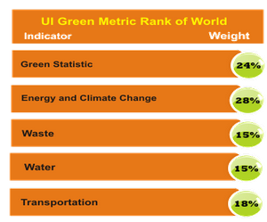


Environment and Sustainability
Which countries could be interested in our position within this rating?
What is the aim to be part of this ranking?

Slide 92
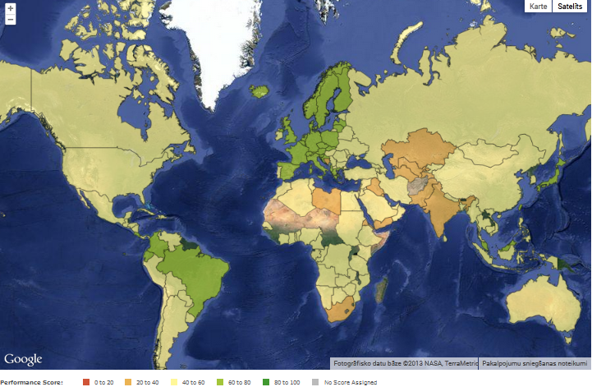
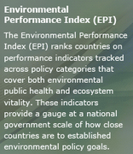
Environmental performance index

Slide 93
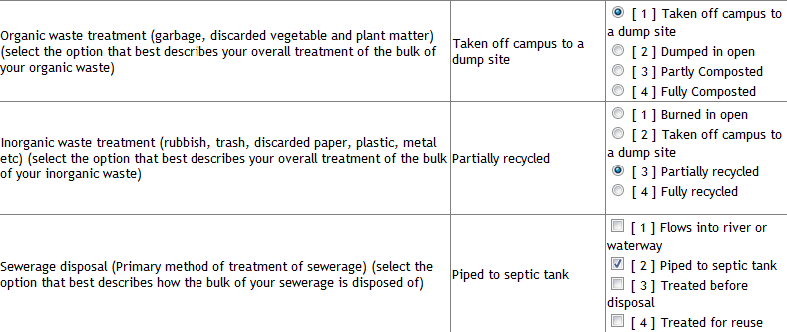
GreenMetric criteria
Electricity usage per year (for lighting, heating, cooling, etc) (Total KWH)
What does the position in the ranking tells about the University of Latvia?
What does it tell about the diversity of HEIs in the world?

Slide 94



GreenMetric criteria
Is it important to be part of this ranking?

Slide 95
Rankings
!!!
Mass HE and globalization provokes interest in comparing the HEIs in a simplified way
Economic crisis requires higher accountability
Governments are utilising rankings to make policy decisions
Rat race
Bias: peer review; language; regional; natural sciences vs. arts and humanities; manipulations

Slide 96
Rankings: policy decisions
!!!
The Brazilian government's national scholarship programme, Science Without Borders, aims to send 100,000 students and researchers in primarily STEM subject areas to some of the world's best institutions. These partner universities were selected based on their position in the QS and Times rankings.
In an effort to ensure quality, India's University Grants Commission also requires any foreign university wanting to partner with Indian universities to be ranked among the top 500 in the world.

Slide 97
Rankings: manipulations
!!!
More Nobel Prize winners
In a well-documented case in the UK in 2008, more than 100 students were told to give glowing reports of their university to improve its standing in the rankings
As USNWR counts full‐time faculty for its student/staff ratio in the autumn term, departments have encouraged their faculty to take academic leave in spring, not in autumn (Espeland & Sauder, 2007)
As several rankings that produce league tables use indicators which reflect the overall product of the university (overall number of Nobel Prize winners, articles, citations, etc.), mergers of universities can improve the position in these rankings
More publications– this could be a positive development, but in practice it simply means more articles in Thomson Reuters − or Scopus-covered journals, rather than in books and other types of publication
Some institutions have put considerable effort into encouraging students to apply, even though they had no chance of ever being accepted (Schreiterer, 2008), thus ensuring that the institutions receive a higher score on Selectivity
In order to raise the average standardised test scores of applicants, some institutions have made the submission of test scores voluntary, in the knowledge that only applicants with a high score have an incentive to do so

Slide 98
Rankings: rat race
!!!
‘World-class University’ estimated to cost min. $1.5-$2b year operation (Usher 2006; Sadlak & Liu 2007; Sowter, 2008).
  This would require 987% or tenfold increase in the total Latvia HE budget being diverting for a single university
According to Sheil (2009), institutional budgets of Harvard, Princeton, Yale and Stanford provide ~ $149,000 ― $227,000 per enrolment.
  The equivalent for Latvia is ~$1,216 per enrolment (2009)
There are in total approx. 4000 science doctors employed in higher education and science sectors in Latvia
  University of Helsinki (Finland) – 3800 acad. staff;
  University of Heidelberg (Germany) – 4200 acad. staff;
  University of Uppsala (Sweden) – 3700 acad. staff;
  Charles Uni in Prague (Czech Rep.) – 4100 acad. staff;
  St.Petersburg State Univ. (Russia) – 5200 acad. staff.

Slide 99
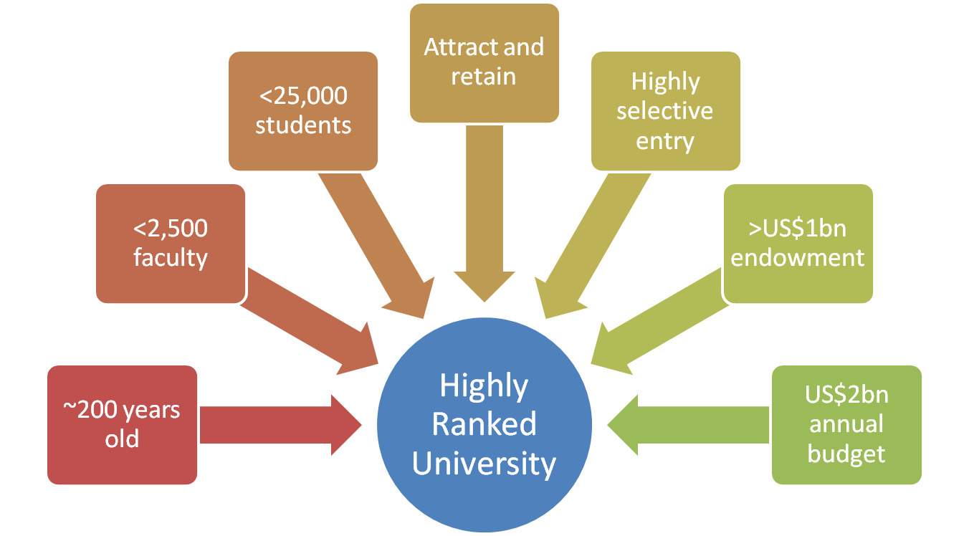
Rankings: Rat Race
!!!
What it takes to become one of the ‘super-league’ of ~25 world-leading institutions
Concentration/specialisation most relevant in only 4 disciplines of ‘big science’ (Moed, 2006)

Slide 100
Ķīlis stāstīja, ka naudu finansēšanas modeļa ieviešanai valsts aizņemsies ārējos tirgos un sākotnēji būtu nepieciešami aptuveni 450 miljoni lati, lai Valsts studiju kreditēšanas fonds varētu sākt darbību.
jaunieši izvēlēsies studēt tuvajās kaimiņvalstīs, kur augstākā izglītība ir bez maksas, nevis uzņemsies parādsaistības
tas, ka augstākā izglītība netiek finansēta no valsts budžeta, ir īslaicīgs un mānīgs iespaids, taču ilgtermiņā tā palielinās valsts parādu
mainoties ekonomiskajai situācijai, palielinās riski
milzīga naudas masa, kas aptuveni 25 gadus ir jāapkalpo un ir jārēķinās, ka no valsts budžeta nāksies atgriezt aptuveni 20% zaudējumu
Izbeigsies gadu simtiem iedibinātais princips, ka vecākā paaudze maksā par jaunākās paaudzes izglītību un labklājību, kā dēļ pieaugs egoisms sabiedrībā un palielināsies plaisa starp paaudzēm
valsts budžeta vietu aizstāšana ar valsts kredītiem neveicinās jauniešu izvēli par labu salīdzinoši dārgākām studiju programmām
jāpieaug Valsts ieņēmumu dienesta kapacitātei cīnīties ar aplokšņu algām
SEA, par 1 stud, kreditēšanas probl(galv,nodokļi), antropologs

Slide 101
Tool that was used in the case of University of Latvia..
_ _ _ _ _ _ _ _ _ _ _ _ (12 letters)
[HINT] this process is used in management and particularly strategic management, in which organizations evaluate various aspects of their processes in relation to best practice companies' processes, usually within a peer group defined for the purposes of comparison

Slide 102
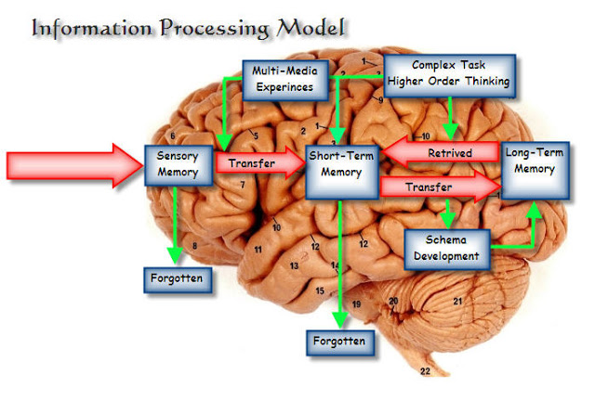
Cognitive learning
Learning is attainment of cognitive structure in which human process and store information.
Schema is an internal knowledge structure, basic building block of intelligent behavior, a way of organizing knowledge.
Learning is a process where new info is accepted while previous information will be altered, combined or extended to accommodate the new information.
Jean Piaget (1896 –1980)
Swiss developmental
psychologist and
philosopher

Slide 103
The course is redundant, I have already heard all of this before

Slide 104
The course is redundant, I have already heard all of this before
learn to focus on positive things

Slide 105
THANK YOU!

