Slide 1
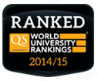
ENHANCING CAPACITES IN IMPLEMENTATION OF INSTITUTIONAL QUALITY ASSURANCE SYSTEMS AND TYPOLOGY USING BOLOGNA PROCESS PRINCIPLES:
in two Central Asian regions – Kazakhstan and Uzbekistan (partner countries), with the emphasis on internal quality assurance and institutional typology
Intro: IQAT project
Part 1: University of Latvia
Part 2: Local vs.Foreign
A. Rusakova, Dr.sc.admin. University of Latvia
Latvian Rectors’ Council
Tashkent, September 5, 2017

Slide 2
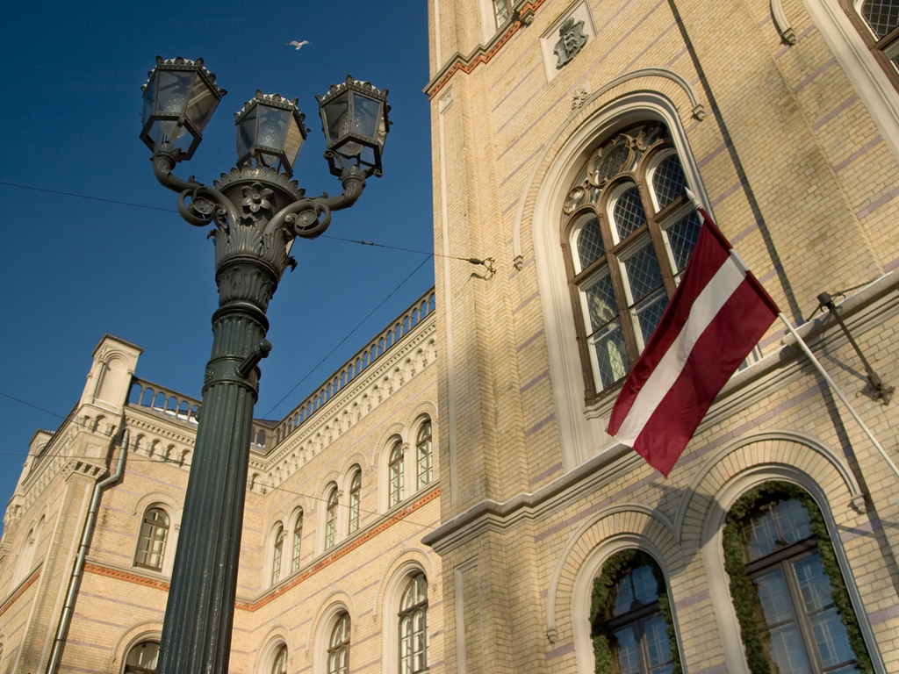
UNIVERSITY OF LATVIA
BRIGHT MINDS. EXCELLENT PLACE.

Slide 3
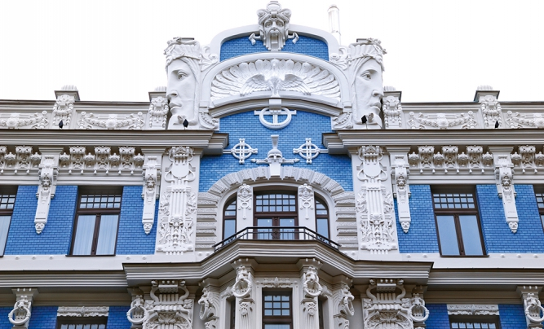
Capital, Riga
Knowledge hub: majority of higher education institutions located

Slide 4
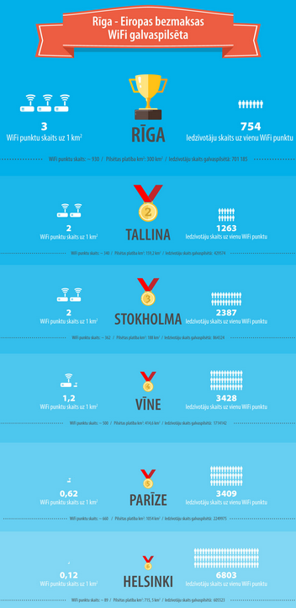
2016
# 8 in the world: Riga
...boasts of internet speeds of over 900 Mbps at the most affordable price of $9.22/month!
# 7 in the world: Latvia
...offers an average internet speed of 12 MBPS to its citizens - Impressive! Fastest in Eastern Europe, by far.
[http://www.dospeedtest.com/blog/which-city-has-the-worlds-fastest-internet-in-2016/]

Slide 5
QUANTUM COMPUTING
The citation for the 2012 Nobel Prize for Physics pointed to quantum computing possibly holding out the prospect of transforming our lives in this century as much as ordinary computers did in the last.
‘It’s a radically new way of computing, and it’s the only new way of computing that provides speed-ups by orders of magnitude,’ said Prof. Ambainis [from the University of Latvia], who coordinates the Quantum Computer Science (QCS) consortium, an EU-funded collaboration of eight research teams working on quantum computing problems.
[http://horizon-magazine.eu/article/quantum-leap-computing_en.html]
Quantum pumping electrons in nano devices, in mesoscopic systems. Prof Kascejevs

Slide 6
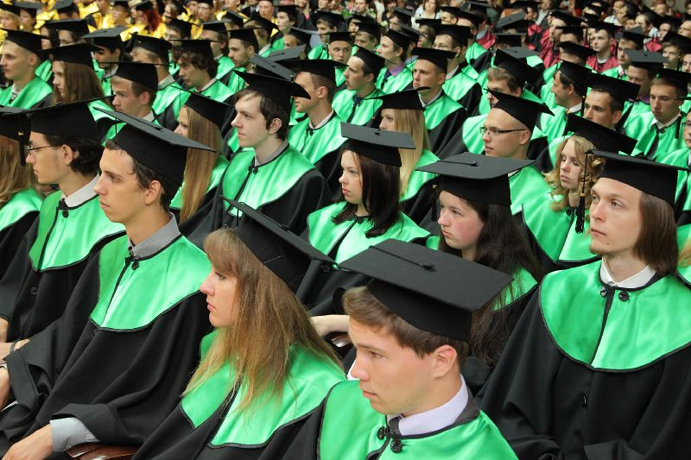
UNIVERSITY OF LATVIA
20% of all students in Latvia are students
of the University of Latvia

Slide 7
UNIVERSITY OF LATVIA IN RANKINGS (2016)
Governmental, nationally significant
Times Higher Education Ranking: 701+. Stable position.
QS World Top Universities (Quacquarelli Symonds): 651+. Among 5% of world’s top universities. Up from 701+.
Webometrics: 1016: Among 5% of world’s top universities. This rating rates internet presence of 21 000 HEIs in the world.

Slide 8
GENERAL INFORMATION
13 faculties and 2 medical colleges
7 research institutes + 9 research institutes as University agencies
Study programmes 134
12 100 students in total, 855 doctoral students;
2800 total staff, int.al. 900 academic staff
research oriented:
45% science impact of Latvia

Slide 9
Solid State Physics Institute
Horizon 2020 “WIDESPREAD 1-2014: Teaming” framework
Project CAMART2 won 5th place out of 169
Nanomaterials, photonics and high materials
15 mio EUR
Open lab
Freshly won!!!

Slide 10
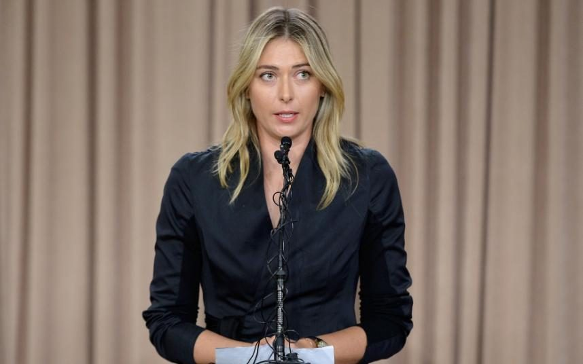
Meldonium out ☹

Slide 11
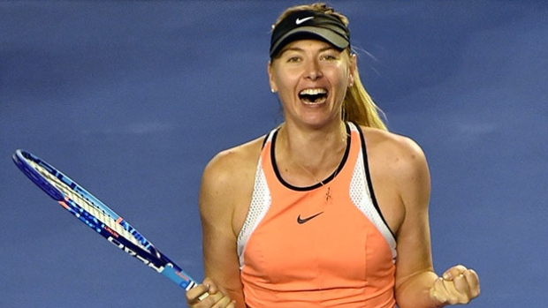
Super-Meldonium in!!! ☺
cardioprotective substance 40 times more active than meldonium / Prof. M. Dombrava

Slide 12
Study programs in English
Bachelor level (medicine, dentistry, computer science, management, philology, optometry,
chemistry);
Master level (humanities, pedagogy, sociology, European
Studies , MBA in Export management,);
Doctoral level (biology, demography, education, environmental sciences, geology, geography, management, psychology, theology, political science, philosophy).
Joint programs – MISOCO, MBA with specialization in Export
management, Educational Treatment of Diversity
European Center of Excellence in Photonics
Marie Curie chair
Successful transplantation of stem cells in heart of a newborn with substantial heart defects
33% graduate students

Slide 13
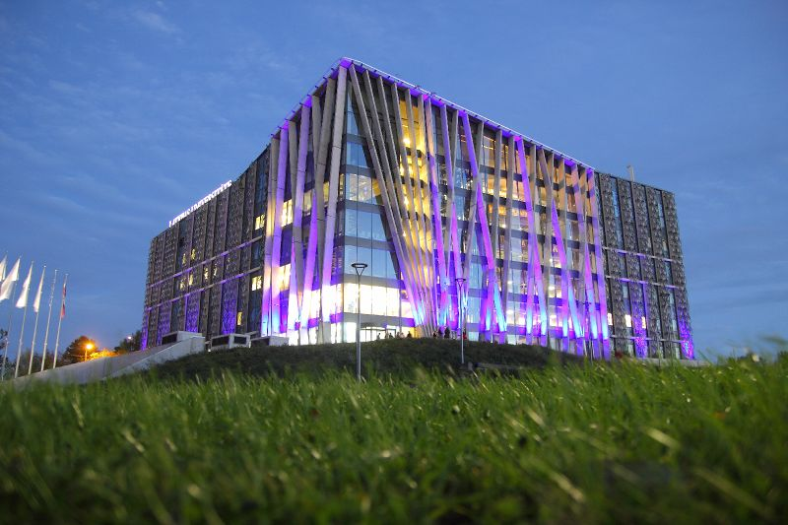
CENTRE OF NATURAL AND MEDICAL SCIENCES
modern infrastructure that meets the highest academic standards of the world’s top universities (buildings,
equipment and facilities) for studies and research

Slide 14
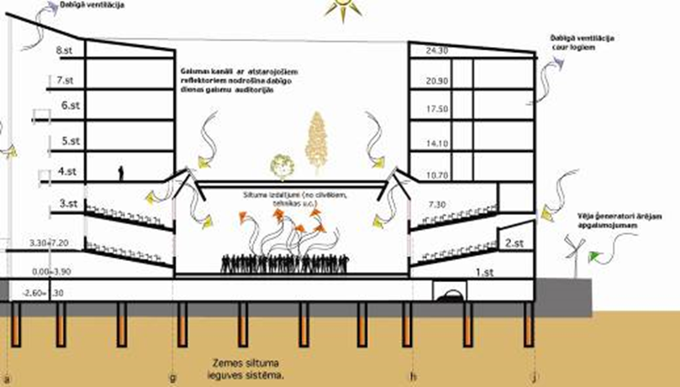
CENTRE OF NATURAL AND MEDICAL SCIENCES

Slide 15
Local vs. foreign

Slide 17
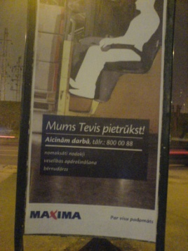
Limitations of human’s cognitive abilities
Procesa automatizācija, ātrāka lēmuma pieņemšana
savējie vs. svešie
Klasifikācijas, stereotipi
Limited information sensing ability
Limited information processing ability (use of mental short-cuts, number of key variables e.g. cognitive heuristics (Janis, 1989))
Limited information storage capacity - cognitive maps (McCaskey, 1982), construed reality (Finkelstein, Hambrick, 1996)
Cognitive rigidity - people tend to significantly overestimate the value of information that confirms their cognitive maps and seek out evidence that supports their beliefs (Schwenk, 1984)
Cognitive maps constructed through interaction – shared reality (Daft and Weick, 1984), group’s dominant logics (Prahalad and Bettis, 1986), belief system (Noorderhaven, 1995), which can be shared by any group (e.g. family, firm, industry, nation
Kādas profesijas bērnībā zinājāt?
Kas meklē, tas atrod..
Kāda ir atšķirība starp Vadībzinību studentiem un Filozofijas studentiem?

Slide 18
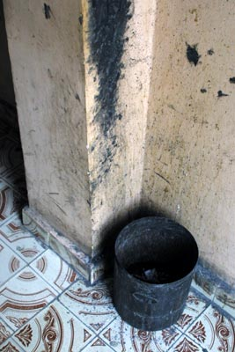
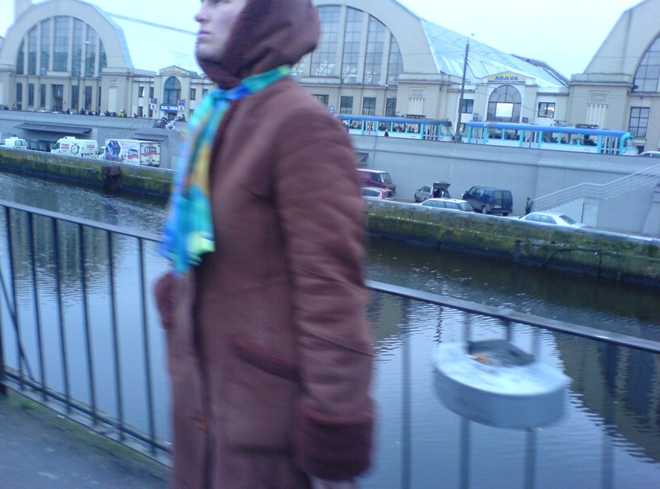
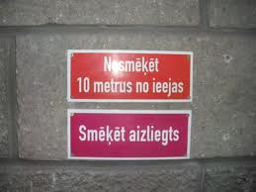
Apply the basics of consumer perception to create the product/service

Slide 19
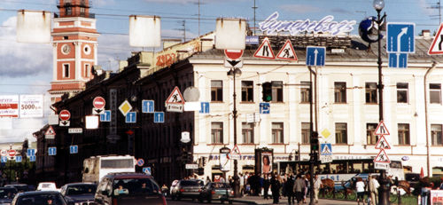
Which lane to choose to get straight ahead from here?
Environment is complex
Knowing the environment’s main features helps evading most common mistakes

Slide 20
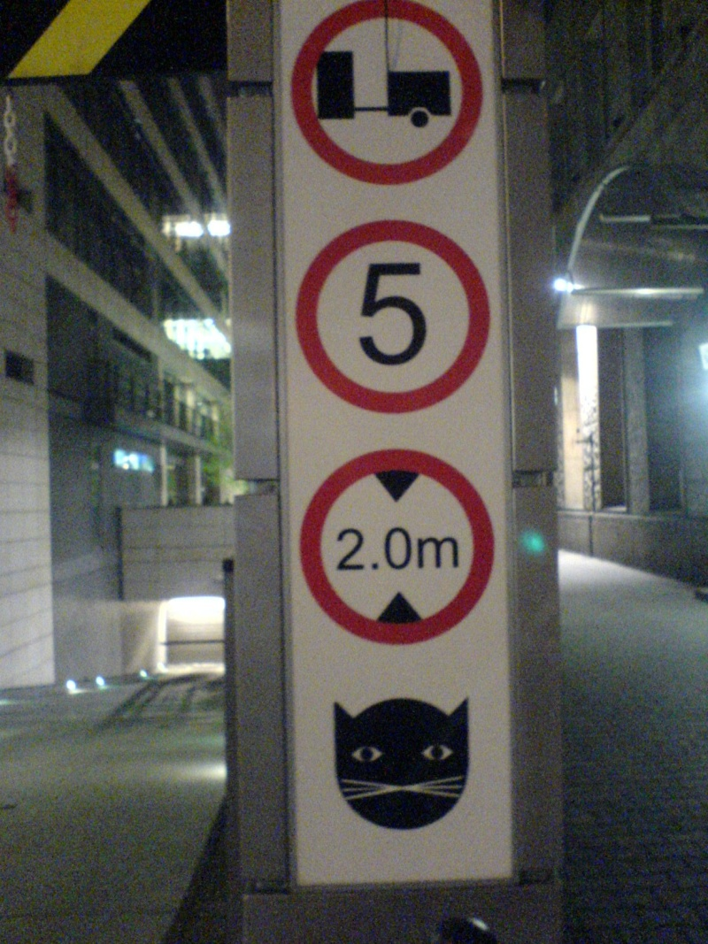
Is it important to know theory? Can we rely on theory alone?
Tools are necessary for categorizing and thus simplifying the environment = theory!
Each theory involves limitations, because it simplifies
Teorija: suņa izskats
stereotips = teorija?

Slide 21
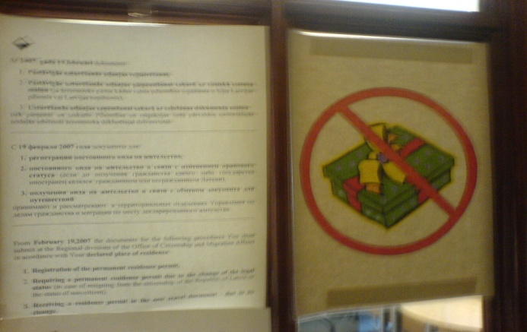
Be ready to make mistakes when going international
Studying matters, same as having practical experience

Slide 22
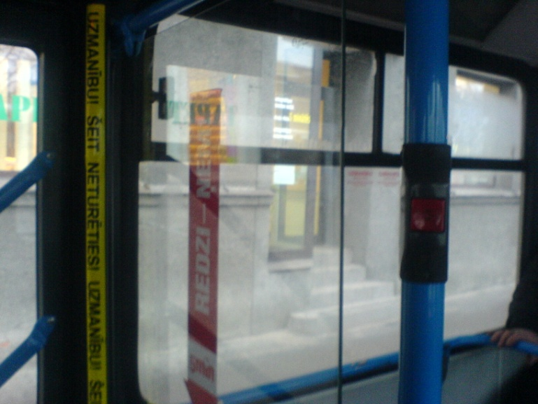
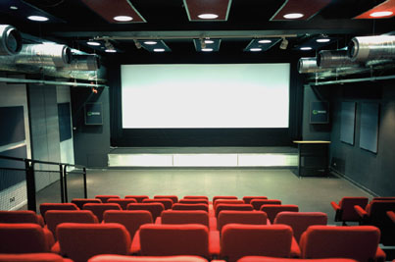
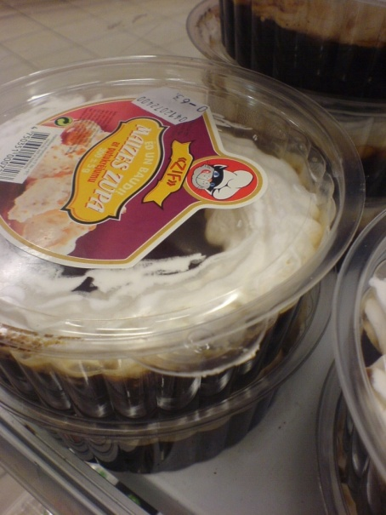
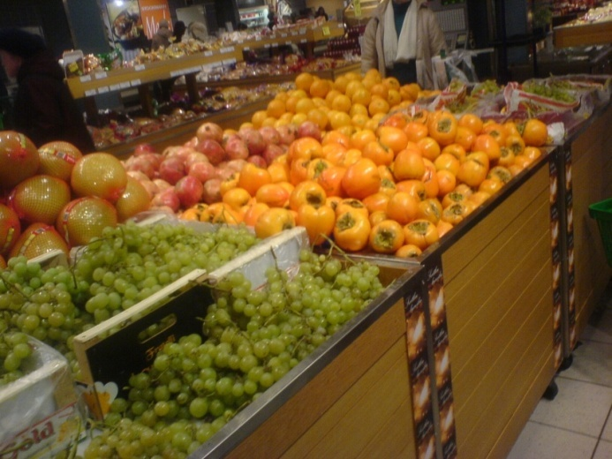
students/pasniedzējs = cilvēks

Slide 23
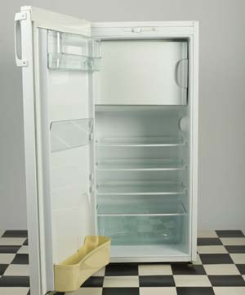
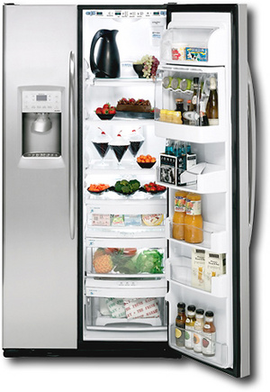
Mēs visi esam vienādi!

Slide 24
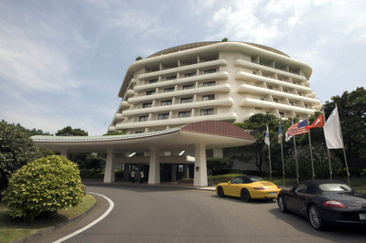

Slide 25
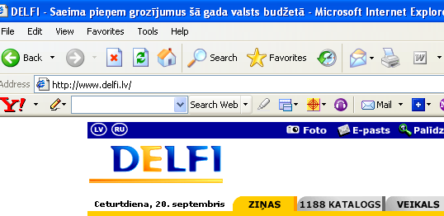
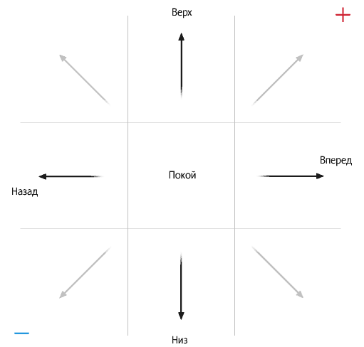
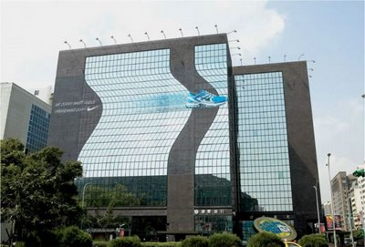
Motion

Slide 26
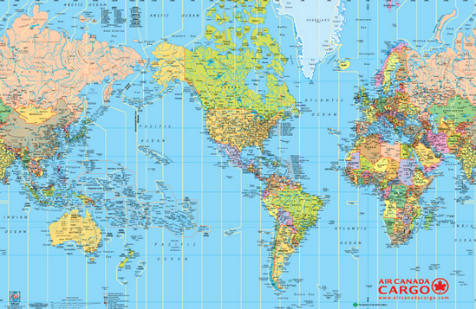
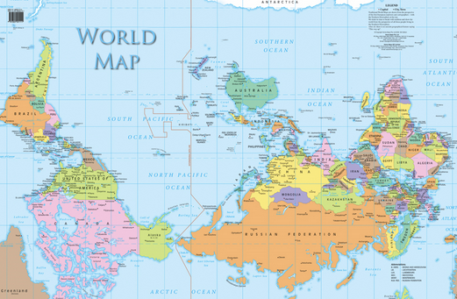
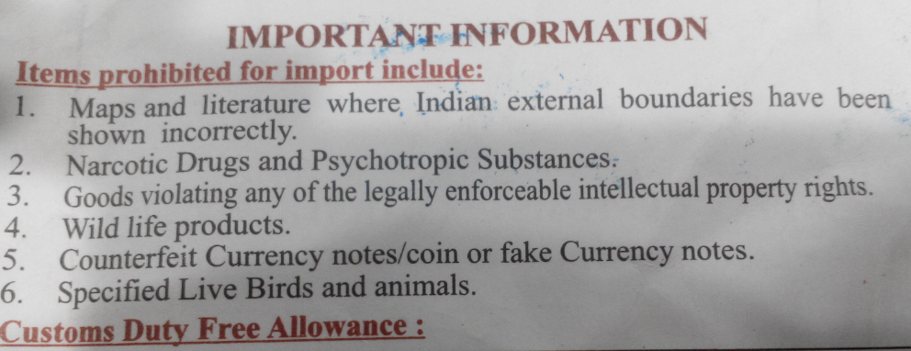

Slide 27
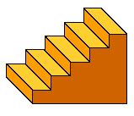
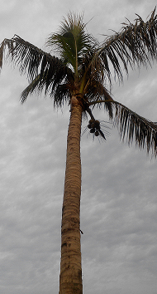
Mēs visi esam vienādi?

Slide 28
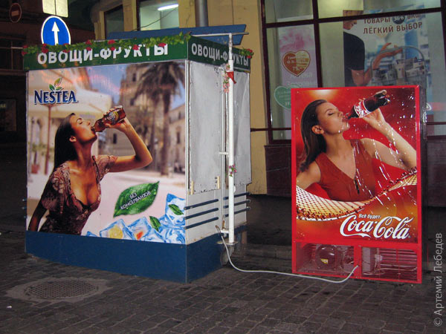
austrumi
Mēs visi esam vienādi?
rietumi
apvērsts logo

Slide 29
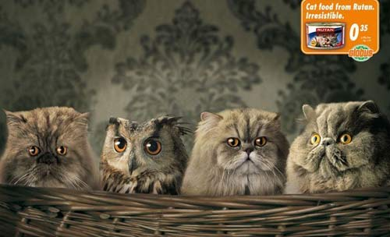
Symbols

Slide 30
19 Raina Blvd., Riga LV 1586, Latvia Phone +371 67034334 ad@lu.lv www.university.lv
twitter.com/lvuniversity
facebook.com/latvijasuniversitate
youtube.com/universitatelv

