Slide 1
Quality Assurance System. Introduction
Dr. Alberts Prikulis
University of Latvia
Alberts.prikulis@lu.lv

Slide 2
Quality Assurance
Internal QA: each actor can assure himself and other involved people; the institution can assure istelf and its stakeholders
External QA: external stakeholders and authorities have procedures to assess the work of the institution and assure everybody

Slide 3
What is Quality?
Fitness for purpose (for product)
Meeting the needs/requirements of client (for services)
Notes:
A few words about notion of quality.
Definitions developed in the middle of the last century with quality management coming into fashion. This is just to show that one should speak of quality only in the context of functioning of the product or the service. Above all one should not compare products that have different usage or services designed for different clients. If we speak about HE we cannot say that its quality in a country like LV is higher or lower than in KZ or UZ unless we decided to have a common labour market (for which our HE is providing specialists, as one of the objectives).

Slide 4
Product and service in HE
Source material (totality of knowledge, skills and competencies of the applicant)

[Academic process (service)]

Product (totality of knowledge, skills and competencies of the graduate – “learning outcomes”)
Notes:
Why we can apply the definitions to HE at all. The fact is that academic process just as any production processes has certain source (raw) material that is developed (processed) into some product. The process itself can be considered as a service provided to those who benefit from the ‘product’. What makes HE (and education in general) different is that students are both as the ‘material’, ‘actors’, and the ‘main beneficiaries’. This should be born in mind when one speaks about students’ role in QA

Slide 5
Learning outcomes
Knowledge (In the context of EQF*, knowledge is described as theoretical and/or factual).
Skills - cognitive (involving the use of logical, intuitive and creative thinking), and practical (involving manual dexterity and the use of methods, materials, tools and instruments)
Competencies (competence is described in terms of responsibility and autonomy).
* https://ec.europa.eu/ploteus/content/descriptors-page
Notes:
I will not comment on it, only show you what it is about

Slide 6
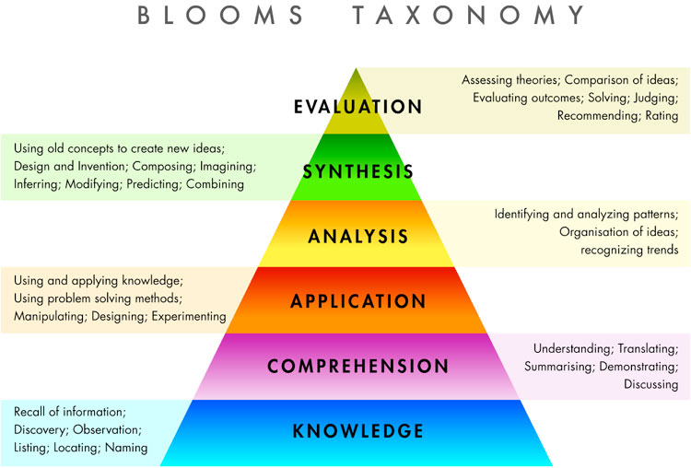

Slide 7
Clients/stakeholders of the academic process
Internal | External
Students Colleagues Staff of further study stages Faculty management Institutional management … | Employers Graduates Government institutions Wider society HEIs abroad …
Notes:
What else makes academic process different from e.g. production of manufactured goods is that there is a number of persons or institutions who are concerned with the process or its result and are affected by it, students are the ones affected crucially, as already mentioned. Therefore it is complicated to find out the ‘requirements of the client’

Slide 8
Quality in a multi-client situation
Fitness for purpose Meeting the standards for ‘product’ | Professional standards/ Educational standards
Meeting the needs/requirements of client for ‘services’ Meeting the standards of the academic process | Standards and guidelines for quality assurance in European Higher Education Area (ESG)
Notes:
The solution in a multi-client situation is the requirements for ‘products’ and for ‘services’ have to be standardised (at National or European level)
There are National standards on bachelor, master and doctor studies as well as 1st and 2nd level professional studies adopted by Cabinet of Ministers between 2000 and 2014. ESG have been adopted by the Education Council of EU in 2005 and revised in 2014. And we should notice that standards can be developed both for products and services. The conviction is that having conformity with the standards for the academic process, we stand a high chance to ‘produce’ a quality ‘product’.

Slide 9
1.1. Policy and procedures for QA
Institutions should have a policy for QA that is made public and forms part of their strategic management. Internal stakeholders should develop and implement this policy through appropriate structures and processes, while involving external stakeholders.
Policies and processes are the main pillars of a coherent QA system … The policy has a formal status and is publicly available
Notes:
Now I will try to illustrate the internal QA in our institution.
Altogether there are more than 100 internal regulations concerning academic process, and most of them are directly or indirectly following the ESG, although not specifically referring to it. And we have to start with 1.1.

Slide 10
1.2 Design and approval of programmes:
Institutions should have processes for design and approval of programmes. The programmes are designed so that they meet the objectives set for them, including the intended learning outcomes. The qualifictaion resulting from a programme should be clearly specified and communicated, and refer to the correct level of the NQF, and consequently to the framework for qualifications of the EHEA.
Notes:
The study programme level will be dealt specifically with my colleague Anda Prikšāne; here I will just mention what is done in this respect at the central management level.
Regulations on Directors of Study programmes, Heads of sub-programmes, Staff descriptions, Regular electronic polls for evaluation of studies are also adopted at central level (Senate or Rector). The same concerns development and revision of study programmes and individual courses.

Slide 11
1.3 Student-centered learning, teaching and assessment:
Institutions should ensure that the programmes are delivered in a way that encourages students to take an active role in creating the learning process, and that the assessment of students reflects this approach.
Notes:
Student assessment is done at the level of study programme or individual course, but again, the procedures are definmed at the central level.

Slide 12
1.4 Student admission, progression, recognition and certification:
Institutions should consistently apply pre-defined and published regulations covering all phases of the student life-cycle, e.g. student admission, progression, recognition and certification.
Notes:
Student assessment is done at the level of study programme or individual course, but again, the procedures are definmed at the central level.

Slide 13
1.5 Teaching staff: Institutions should assure themselves of the competence of their teachers. They should apply fair and transparent sprocesses for the recruitment and development of the staff.
Notes:
Teaching staff is one of the crucial things in the academic process, and certain requirements have been established at the National level. Inter alias, there are certain requirements for proportion of staff having academic and scientific degrees, according to National typology of HEIs. Apart from that we have internal regulation on staff. A specific procedure has been defined for election of staff.

Slide 14
1.6 Learning resources and student support: Institutions should have appropriate funding for learning and teaching activities and ensure that adequate and readily accessible learning and student support are provided.
Notes:
The main resource is the forms of teaching and learning provided at the SP and individual level. At he institutional level we have a number of support forms that are maintained adminstratively and financially from the institutional budget.

Slide 15
1.7 Information management:
Institutions should ensure that they collect, analyse and use relevant information for the effective management of their programmes and other activities.
The information gathered…: Key performance indicators Profile of the student population Student progression, success and drop-out rates Students satisfaction with their programmes Learning resources and student support available Career paths of graduates
Notes:
As concerns the information systems, they are also maintained centrally and used by students and academic and administrative staff to store, manage and use the relevant information.

Slide 16
1.8 Public information:
Institutions should publish information about their activities, including programmes, which is clear, accurate, objective, up to date, and readily accessible.
Notes:
The university makes its information available to public mostly electronically (via internet), but there also regularly renewable leaflets on faculties and programmes distributed in information events. There are also periodical publications about faculties and the university in a format of books, also containing quantitative data about the programmes and awards. (2 years ago, by the way, we completed and published a book about 50 years of Chemistry Faculty, containing a chapter on current SP).

Slide 17
1.9 On-going monitoring and periodic review of programmes:
Institutions should monitor and periodically review their programmes to ensure that they achieve the objectives set for them and respond to the needs of students and society. These reviews should lead to continuous improvement of the programme. Any action planned or taken as a result should be communicated to all those concerned
Notes:
The university makes its information available to public mostly electronically (via internet), but there also regularly renewable leaflets on faculties and programmes distributed in information events. There are also periodical publications about faculties and the university in a format of books, also containing quantitative data about the programmes and awards. (2 years ago, by the way, we completed and published a book about 50 years of Chemistry Faculty, containing a chapter on current SP).

Slide 18
1.10 Cyclic external quality assurance:
Institutions should undergo external quality assurance in line with the ESG on a cyclic basis
…institutions ensure that the progress made since the last external QA activity is taken into consideration when preparing for the next one
Notes:
The university makes its information available to public mostly electronically (via internet), but there also regularly renewable leaflets on faculties and programmes distributed in information events. There are also periodical publications about faculties and the university in a format of books, also containing quantitative data about the programmes and awards. (2 years ago, by the way, we completed and published a book about 50 years of Chemistry Faculty, containing a chapter on current SP).

Slide 19
IQAT partners
Czech University of Life Sciences Prague (CZ)
Centre for Higher Education Studies (CZ)
University of Alicante (ES)
Constantine the Philosopher University in Nitra (SK)
University of Latvia (LV)
Tashkent Chemical-Technological Institute (UZ)
Samarkand Agricultural Institute (UZ)
Andijan State University
S.Seifullin Kazakh Agro Technical University (KZ)
International Educational Corporation (KZ)
Karaganda State Technical University (KZ)

Slide 20
Tasks
mapping the situation in the field of QA
interactive training (seminar, 2 workshops including practical training, visits to CZ HEIs)
exploitation U-map methodology, typology of HEIs
pilot implementation of new/innovated/modified drafts of internal QA systems at HEIs in PaCs,
development of final versions of internal QA systems

Slide 21
What about the system?
Quality policy of the institution
Description of the new or modified parts of QAS
Referenced to ESG
Linked to institutional and National procedures
Self-assesment

Slide 22
What is demonstrated and evaluated in the Self-assessment report of a study programme?
Data on students’ number and results (1-st year students (entrance score), graduate results, drop-out level, etc.) which demonstrate the demand of the program and students’ interest,
Course content in line with the needs of labour market and society and with the achievements in the appropriate science field,
Qualification of academc staff and program resourses,
Students’ satisfaction with study courses and teaching methods,
Employability of graduates and employers’ satisfaction with graduates,
SWOT analysis and plan of development and maintenance of the program to ensure the sustainability of the program.

Slide 23
Acknowledgement and disclaimer
This project has been funded with support from the European Commission within Erasmus+ programme.
This presentation reflects the views only of the authors, and the EC cannot be held responsible for any use which may be made of the information contained therein.
Notes:
These are compulsory statements for EU-funded projects one has to include in publications funded from EC

Slide 24
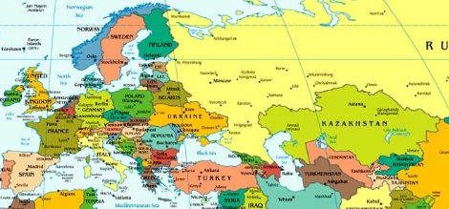
Thank you for your attention!
Paldies! Rahmat!

