Slide 1
Practice of involvement of lecturers in internal QA
Dr. Alberts Prikulis
University of Latvia
alberts.prikulis@lu.lv
Praha, 8.06.2017

Slide 2
About LV and UL
General principles
Observations about internal QA system
Self-evaluation of teachers
Additional reference material
Notes:
Our presentation will be dealing with quality assurance issues at 3 levels. In the beginning I will mention some facts about Lavia and UL and remind you some basics concerning quality.

Slide 3
Latvia
Situated in Northern Europe, on the coast of Baltic Sea; Capital: Riga
Founded: November 18, 1918;
European Union: since 2004; Eurozone: since 2014;
Presidency of the Council of the European Union in 2015;
Annual GDP growth up to 4,5%;
Economy and exports: logistics, high-tech, chemicals, pharmacy, agriculture, woodwork
Population: 1 984 887 in 2016;
Ethnic composition: latvians 61.4%, russians 26%, belarusians 3.4%, ukrainians 2.3%, others;
Students: 85.9 thsd in 2015; Higher education institutions: 60
Notes:
Latvia exists as an independent country since 1918, with an interruption between 1940 and 1991 when it was incorporated in the Soviet Union. It has a number of HEIs (including colleges), out of which about 1/3 are state-founded.

Slide 4
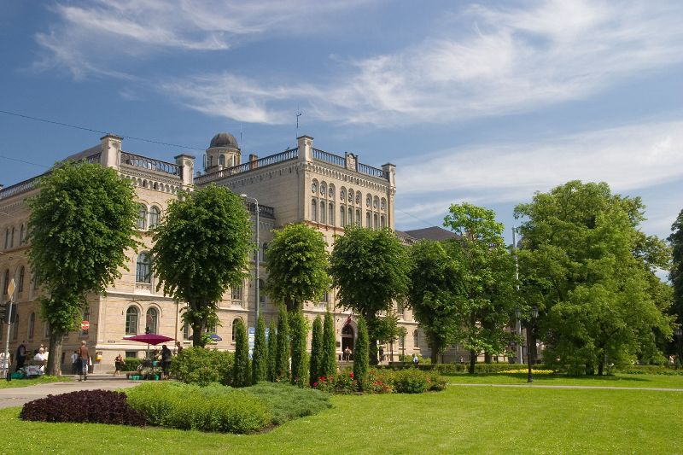
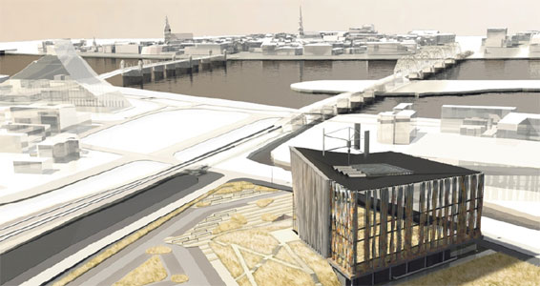
University of Latvia
Founded: September 28, 1919
Students: 13 055, 2016
QS World University Rankings 15/16: 651-700
Faculties: 13
Institutes: 12+3
Study programmes: 130 (undergraduate 53, postgraduate 53, doctoral 24)
Staff: 2283 (academic 1151, other 1132)
Opening of the new campus on
September, 2015
Notes:
HE in Latvia existed since XIX century (Riga Polytechnic was established by Russian tsar’s decree in 1896). When with the end of the WW1 Latvia was established as an independent state, one of the 1st steps was to develop the National university. Over the years it has been largest or 2nd largest HEI in Latvia. In 1957 and 1958 some faculties split off to form new HEIs (by decision of Soviet government). After restitution of independency in 1991 and until present some of the faculties have been reestablished (such as Chemistry faculty in 1964. UL does not have engineering faculties (those are found in RTU, former RPI that split off in 1958 and for some period had developed into the largest HEI), but it has studies in medicine and pharmacy (in parallel to a separate large specialized university that developed starting with splitting off from UL in 1957 as the Riga Medicine Institute.
A new campus has started with the building of Natural sciences (including our faculty) in 2015

Slide 5
What is Quality?
Fitness for purpose (for product)
Meeting the needs/requirements of client (for services)
Notes:
A few words about notion of quality.
Definitions developed in the middle of the last century with quality management coming into fashion. This is just to show that one should speak of quality only in the context of functioning of the product or the service. Above all one should not compare products that have different usage or services designed for different clients. If we speak about HE we cannot say that its quality in a country like LV is higher or lower than in KZ or UZ unless we decided to have a common labour market (for which our HE is providing specialists, as one of the objectives).

Slide 6
Product and service in HE
Source material (knowledge, skills and competencies of applicants)
↓
Students conditions ↕ [Academic process (service)] Lecturers stakeholders
↓
Product (knowledge&skills of graduates – “learning outcomes”)
Notes:
Why we can apply the definitions to HE at all. The fact is that academic process just as any production processes has certain source (raw) material that is developed (processed) into some product. The process itself can be considered as a service provided to those who benefit from the ‘product’. What makes HE (and education in general) different is that students are both as the ‘material’, ‘actors’, and the ‘main beneficiaries’. This should be born in mind when one speaks about students’ role in QA

Slide 7
Clients/stakeholders of the academic process
Internal | External
Students Colleagues Staff of further study stages Faculty management Institutional management | Employers Graduates Government institutions Wider society HEIs abroad …
Notes:
What else makes academic process different from e.g. production of manufactured goods is that there is a number of persons or institutions who are concerned with the process or its result and are affected by it, students are the ones affected crucially, as already mentioned. Therefore it is complicated to find out the ‘requirements of the client’

Slide 8
Quality in a multi-client situation
Fitness for purpose Meeting the standards for ‘product’ | Professional standards/ Educational standards
Meeting the needs/requirements of client for ‘services’ Meeting the standards of the academic process | Standards and guidelines for quality assurance in European Higher Education Area (ESG)
Notes:
The solution in a multi-client situation is the requirements for ‘products’ and for ‘services’ have to be standardised (at National or European level)
There are National standards on bachelor, master and doctor studies as well as 1st and 2nd level professional studies adopted by Cabinet of Ministers between 2000 and 2014. ESG have been adopted by the Education Council of EU in 2005 and revised in 2014. And we should notice that standards can be developed both for products and services. The conviction is that having conformity with the standards for the academic process, we stand a high chance to ‘produce’ a quality ‘product’.

Slide 9
1.1. Policy and procedures for QA
Institutions should have a policy for QA that is made public and forms part of their strategic management. Internal stakeholders should develop and implement this policy through appropriate structures and processes, while involving external stakeholders.
Policies and processes are the main pillars of a coherent QA system … The policy has a formal status and is publicly available
Notes:
Now I will try to illustrate the internal QA in our institution.
Altogether there are more than 100 internal regulations concerning academic process, and most of them are directly or indirectly following the ESG, although not specifically referring to it. And we have to start with 1.1.

Slide 10
External requirements, and strategic objectives form the structure of QMS of UL… (from Order Nr.1/338 of 19.12.2012. “Process management in University of Latvia”)
Notes:
Quality policy defines continuous development towards excellence in research-based studies as the aim of Quality assurance system [of studies]. The model of excellence and Regulation on process management sets guidelines for building, assessment and development of the system of quality management of studies, an is represented in the model of electronic process management – LU QuPeRs. The regulation on process management has been adopted on 19.12.2012. LU order Nr.1/338)
Study processes are clearly structured and there are responsibles for each of them. Collective responsibility belongs to the decision-making bodies - Constitutional assembly, Senate, Committee of assessment of quality of study programmes (CAQSP), Faculty boards un Study programme councils (SPC); they evaluate study quality and decide on measures for ensuring the quality of studiies in UL. Administration of UL is responsible for functioning of quality management system and performs monitoring and audits of study process.
Regulation on CAQSP has been adopted on 17.03.2010. UL order Nr.1/66)
Regulation on SPC has been adopted on 25.05.2009. Senate decision Nr.248)
Regulation on Administration has been adopted on 21.09.2009. Senate decision Nr.33)

Slide 11
UL process management module
International cooperation
Purchases
Staff management
Project management
Filing
Maintenance of infrastructure
IT management
Financial management
UL management
Strategic planning
Internal audit
Quality management
Administration reports
SCIENCE
STUDIES
INTERACTION WITH SOCIETY

Slide 12
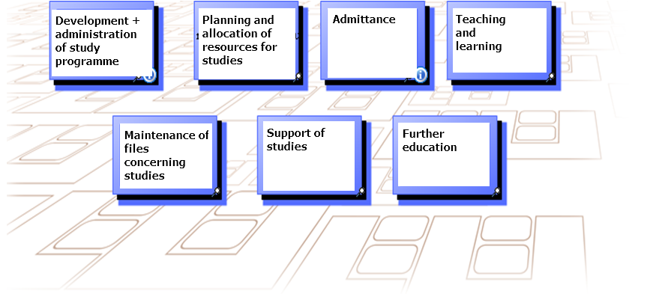
UL process management module - STUDIES

Slide 13
UL process management module – STUDIES : Teaching and learning

Slide 14
1.2 Design and approval of programmes:
Institutions should have processes for design and approval of programmes. The programmes are designed so that they meet the objectives set for them, including the intended learning outcomes. The qualifictaion resulting from a programme should be clearly specified and communicated, and refer to the correct level of the NQF, and consequently to the framework for qualifications of the EHEA.
Notes:
The study programme level will be dealt specifically with my colleague Anda Prikšāne; here I will just mention what is done in this respect at the central management level.
Regulations on Directors of Study programmes, Heads of sub-programmes, Staff descriptions, Regular electronic polls for evaluation of studies are also adopted at central level (Senate or Rector). The same concerns development and revision of study programmes and individual courses.

Slide 15
Evaluation and adoption of a study programme
Notes:
Here we can view the algorithm of the process of evaluation and adoption a separate study programme, starting with preparation of the self-evaluation report and ending with its implementation or closure (depending on the results).

Slide 16
1.3 Student-centered learning, teaching and assessment:
Institutions should ensure that the programmes are delivered in a way that encourages students to take an active role in creating the learning process, and that the assessment of students reflects this approach.
Notes:
Student assessment is done at the level of study programme or individual course, but again, the procedures are definmed at the central level.

Slide 17
On requirements for preparation and renewal of study courses (Rector’s order)
On types and forms of studies (Rector’s order)
Regulation on individual plans of studies (Rector’s order)
Internal rules of order for students (Senate)
On organization of studies of foreign languages (Rector’s order)
On organization of e-studies (Rector’s order)
On practical placements in academic study pr. (Rector’s order)
Order of registration and accounting of attendance (Rector’s order)
Regulation of Council of study programmes of UL (Senate)
Regulation on student advisors of UL (Rector’s order)
Order of interrupting of studies in UL (Senate)
Order of considering the proposals and complaints of students (Rector’s order)
Order of organization of course examinations (Senate)

Slide 18
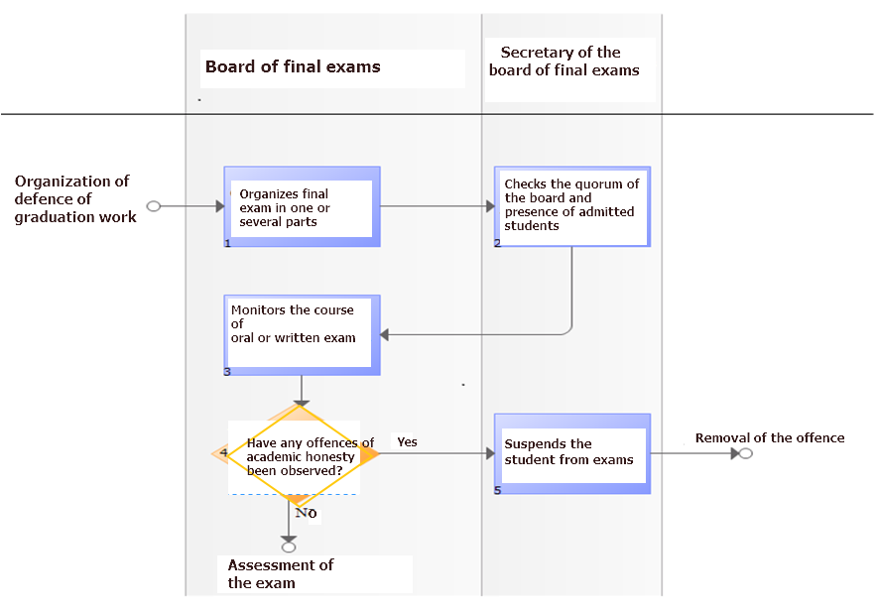
ORGANIZATION OF FINAL EXAMS (QuPeRs)
Notes:
This is an illustration of the process final exams or defence of the graduation work. In each such process we can notice the sequance of actions and the responsible persons or units to do them. You can notice here also the notion of ‘academic honesty’ and how it is dealt with. (It does not show, but, e.g., we have a special software to analyze the presented theses on the subject of plagiarism.)

Slide 19
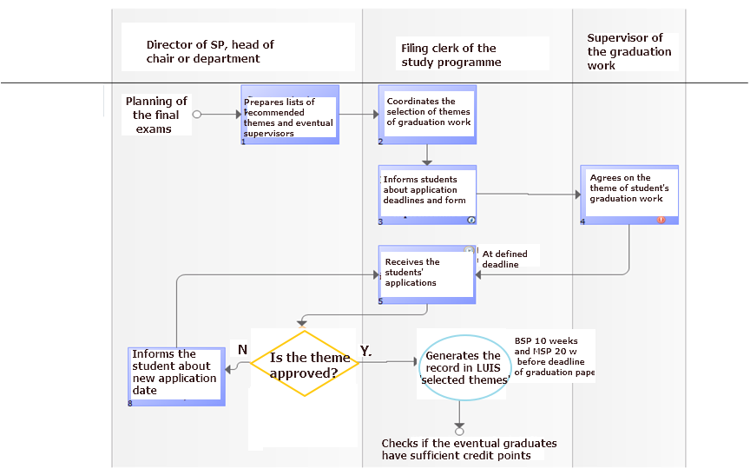
ADOPTION OF THEMES OF GRADUATION WORKS (QuPeRs)
Notes:
A special procedure has been defined for selection of topics and supervisors for graduation works. This concerns Bachelor and Master studies (the doctoral studies are by nature more individual and the topic and the supervisor are known already at the moment of enrolment).

Slide 20
1.4. Student admission, progression, recognition and certification:
Institutions should consistently apply pre-defined and published regulations covering all phases of the student life-cycle, e.g. student admission, progression, recognition and certification.
Notes:
Student assessment is done at the level of study programme or individual course, but again, the procedures are definmed at the central level.

Slide 21
Law on HEIs (Parliament)
Regulation on Enrolment Procedure at the University of Latvia (Senate)
Order for admittance in UL for acad.year 2016/2017 (Rector’s order)
Regulation of admittance committee of UL (Rector’s order)
Agreement on studies in UL (Rector’s order)
Order of organization of course examinations (Rector’s order)
On organization of studies of foreign languages (Rector’s order)
On organization of e-studies (Senate)
On practical placements in academic study pr. (Rector’s order)
On organization of regular opinion polls on assessment of study process (Rector’s order)
Regulation on academic honesty (Senate)
Internal rules of order for students (Senate)
On regulation of committee of academic ethics (Senate)
Information on admittance at all the cycles is published at the internet site for applicants
Study results are accounted and maintained in the portal of e-studies):
On change of medium of e-studies (Rector’s order)
On organization of e-studies (Rector’s order)
Regulation on assessment and recognition of previous study achievements based in previous studies or practical work (Senate)
Order of organization of mobility funded from financial instruments of European Economic Area and Norway (Rector’s order)
Order of interrupting the studies in UL (Senate)
On collecting of questionnaires from those who proposed to interrupt their studies (Rector’s order)

Slide 22
1.5 Teaching staff: Institutions should assure themselves of the competence of their teachers. They should apply fair and transparent processes for the recruitment and development of the staff.
Notes:
Teaching staff is one of the crucial things in the academic process, and certain requirements have been established at the National level. Inter alias, there are certain requirements for proportion of staff having academic and scientific degrees, according to National typology of HEIs. Apart from that we have internal regulation on staff. A specific procedure has been defined for election of staff.

Slide 23
Basic strategic directions of LU (Senate) On Regulation for academic and administrative staff positions (Senate) Regulation for payment for academic labour (Senate) Regulation on Direcors of study programmes (Senate) Duties and rights of Head of subprogram of a Study programme (Rector’s order) On descriptions of staff positions (Rector’s order) Regulation on Administration of UL (Senate) Research programme 2015–2020 (Senate) On organization of mobility funded from financial instruments of EEA and Norway (Rector’s order)

Slide 24
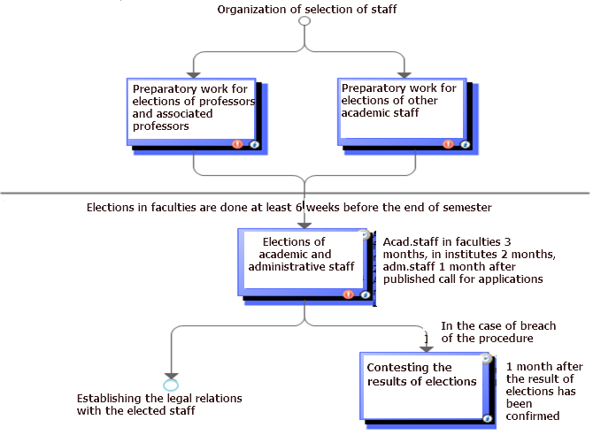
ORGANIZATION OF STAFF ELECTIONS (QuPeRs)
Notes:
It has to be mentioned that staff has to be elected (or re-elected) on a regular basis, and each time there is an open competition for the position. Only in very specific cases a member of academic staff can be established in his/her position just be rectoral decree; this can be done only for the period of 1 year.
The regulation of our institution foresees that before the election, the performance of the candidate is evaluated by colleagues and students (in case of repeated election); if the person is new, he/she is requested to deliver a class on a given topic from one of the prospective courses, and the evaluation is based on this lecture, seminar or such like.

Slide 25
1.6. Learning resources and student support: Institutions should have appropriate funding for learning and teaching activities and ensure that adequate and readily accessible learning and student support are provided.
Notes:
The main resource is the forms of teaching and learning provided at the SP and individual level. At he institutional level we have a number of support forms that are maintained adminstratively and financially from the institutional budget.

Slide 26
Basic strategic directions of UL (Senate) Language policy of UL (Senate) Regulation on Sports games of UL (Rector’s order) Research programme 2015–2020 (Senate) Library (…)

Slide 27
Notes:
In this page I have copied the list of resources in chemistry in electronic form. Most of them are with open access, but the ones locked can be accessed with a password students get free of charge (along with a free copy of MS Office during their studies).

Slide 28
1.7 Information management:
Institutions should ensure that they collect, analyse and use relevant information for the effective management of their programmes and other activities.
The information gathered…: Key performance indicators Profile of the student population Student progression, success and drop-out rates Students satisfaction with their programmes Learning resources and student support available Career paths of graduates
Notes:
As concerns the information systems, they are also maintained centrally and used by students and academic and administrative staff to store, manage and use the relevant information.

Slide 29
Notes:
The main system is LUIS (information system of UL), and it contains all the personal data on students and staff (accessible only in an authorised way so as to meet the requirements of the law on protection of personal data. But it also contains all the records concerning the academic process, and the student can always find out what tasks or tests he has to perform and what is his/her situation with the academic progress. Here also the students can approach centrally organized questionnaires to leave their opinion on programmes, courses and their staff. These opinions are used, i.a., for election of staff and for renewal or amendment of programmes and courses.

Slide 30
Information is accumulated, maintained and processed in LUIS. Information is stored and treated by Data storage unit
Basic strategic directions of UL (Senate)
Research programme 2015–2020 (Senate)
Annual public reports

Slide 31
1.8 Public information:
Institutions should publish information about their activities, including programmes, which is clear, accurate, objective, up to date, and readily accessible.
Notes:
The university makes its information available to public mostly electronically (via internet), but there also regularly renewable leaflets on faculties and programmes distributed in information events. There are also periodical publications about faculties and the university in a format of books, also containing quantitative data about the programmes and awards. (2 years ago, by the way, we completed and published a book about 50 years of Chemistry Faculty, containing a chapter on current SP).

Slide 32
Internet site in 3 languages Law on HEIs => Annual public reports Information published at Faculty web-sites on study programmes and also annual self-evaluation reports Carriere days organized by Carriere centre Portal «Alumni of UL» Center for media and marketing (up-to date information) Basic strategic directions (Senate) Research programme 2015–2020 (Senate) Order on registration and accounting of attendance (Rector’s order)

Slide 33
Notes:
When one enters particular programme, one can see all the basic data about the programme, and also the annotation and the description of aims and tasks of the programme.

Slide 34
Notes:
Information is also available in English, only in a different format, because it is meant for foreigners and not all the study programmes have been duplicated in English. The page about admission contains useful tips and advice on how to become our student.

Slide 35
Notes:
Particular study programmes have a general description in English – as you can see from our Bachelor programme in Chemistry, with attachments containing more detail.

Slide 36
1.9 On-going monitoring and periodic review of programmes:
Institutions should monitor and periodically review their programmes to ensure that they achieve the objectives set for them and respond to the needs of students and society. These reviews should lead to continuous improvement of the programme. Any action planned or taken as a result should be communicated to all those concerned
Notes:
The university makes its information available to public mostly electronically (via internet), but there also regularly renewable leaflets on faculties and programmes distributed in information events. There are also periodical publications about faculties and the university in a format of books, also containing quantitative data about the programmes and awards. (2 years ago, by the way, we completed and published a book about 50 years of Chemistry Faculty, containing a chapter on current SP).

Slide 37
On evaluation and adoption of SP (Senate)
Regulation on Committee of evaluation of quality of SP (Rector’s order)
On requirements for preparation of annual reports of study domains (Rector’s order)
Plan of action for improvement of processes after the audit (Rector’s order)
On collecting the questionnaires from those who propose interrupting of studies (Rector’s order)

Slide 38
1.10 Cyclic external quality assurance:
Institutions should undergo external quality assurance in line with the ESG on a cyclic basis
…institutions ensure that the progress made since the last external QA activity is taken into consideration when preparing for the next one
Notes:
The university makes its information available to public mostly electronically (via internet), but there also regularly renewable leaflets on faculties and programmes distributed in information events. There are also periodical publications about faculties and the university in a format of books, also containing quantitative data about the programmes and awards. (2 years ago, by the way, we completed and published a book about 50 years of Chemistry Faculty, containing a chapter on current SP).

Slide 39
Regulation on accreditation (Cabinet of Ministers) => annual reports of study domains are prepared On requirements for preparation of annual reports of study domains (Rector’s order) Order of evaluation and adoption of study programmes (Senate) On Committee of evaluation of quality of study programmes (Rector’s order) Self-evaluation reports of study domains are published in internet sites of faculties ESG

Slide 40
Results of self-evaluation of teachers

Slide 41
Scale
Entirely disagree | Mostly disagree | Neutral/ can’t tell | Mostly agree | Entirely agree
-2 | -1 | 0 | 1 | 2

Slide 42
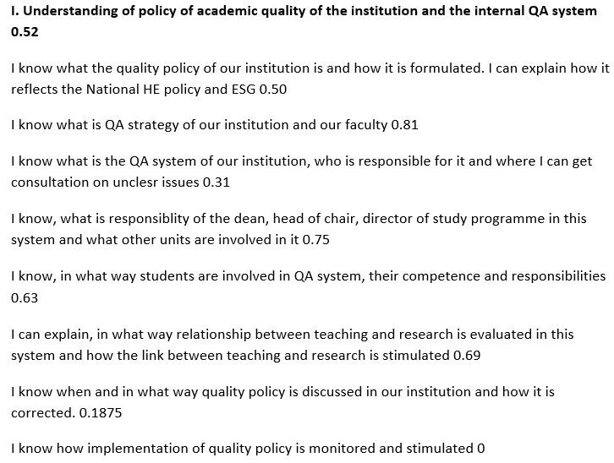

Slide 43
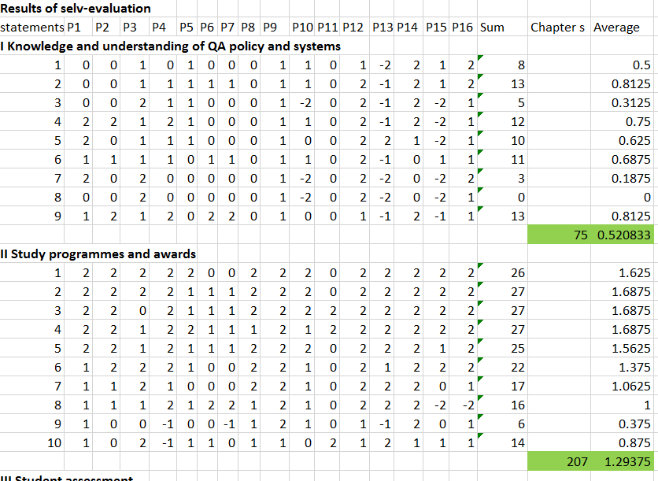

Slide 44
Understanding of quality policy and the internal QA system 0.52
I know what the quality policy of our institution is… | 0.5
I know what is QA strategy of our institution and our faculty | 0.8125
I know what is the QA system of our institution… | 0.3125
I know, what is responsibility of the dean, head of chair, director… | 0.75
I know in what way students are involved in QA system… | 0.625
I can explain, in what way relationship between teaching and research is… | 0.6875
I know when and in what way quality policy is discussed… | 0.1875
I know how implementation of quality policy is monitored … | 0
I know how cooperation with schools is foreseen in the policy … | 0.8125

Slide 45
Study programmes and awards 1.29
I have participated in formulation and publicising of learning outcomes … | 1.625
I can explain the structure and content of the study programme ,,, | 1.6875
I can explain what study forms are present in our study programme … | 1.6875
I can explain what type our SP is (academic, professional, short cycle) … | 1.6875
I know what learning resources are available for our SP and I participate … | 1.5625
I know in what way the SP is evaluated and adopted | 1.375
I know by what means student progress in learning of the programme is… | 1.0625
I participate regularly in discussions about the programme or its parts … | 1
I know results of evaluation of the programme outside the university … | 0.375
I know in what way the programme and its parts are assessed by students | 0.875

Slide 46
Student assessment (I) 1.37
I follow carefully the rules established in the institution … | 1.75
I explain every time:
scale of marks | 1.6875
action in the case of absence | 1.5625
type, method and criteria of the assessment | 1.8125
influence of non-attendance to classes on the mark | 1.1875
arranging the date of the exam | 1.375
I check regularly how other teachers follow the regulations … | 0.25
For this purpose, I have a special plan according to which I inspect … | 0
I strive to permanently improve the process of student assessment … | 1.5625

Slide 47
Student assessment (II) 1.37
I have participated in formulation of student assessment policy … | 0.3125
I regularly take part in explaining assessment procedure and criteria … | 1.5625
During the 1st class I usually ask students to fill in a test of my own … | 1.125
I have a strategy how to develop students’ knowledge, skills and… | 1.8125
In the assessments, I am aware how my exercises and tests … | 1.9375
I seek to develop students’ self-assessment and mutual assessment … | 1.5625
During the final exam of the course I aim at getting a well-grounded opinion on the student’s achievement as the result of studies… | 1.6875
Learning outcomes described for the course matched to learning outcomes of the SP are the main criterion … | 1.8125
There are a few additional measures set to make the students records not depending only on my opinion… | 1.5
During the exam, I am fully aware of all the consequences … | 1.5625

Slide 48
Quality and management 0.51
I know what are the latest changes in national legislation and in by-laws … | 0.8125
I can explain how decision making and taking concerning academic… | 0.375
I have an opinion about strengths and weaknesses of management … | 0.625
how managerial structures and processes influence the quality culture … | 0.125
in what way, the system of monitoring and review of our SP … | 0.375
how often and in what way I can influence the quality … | 0.5625
what are the authorities, responsibilities and freedom of choice … | 0.25
Formulation and publishing the learning outcomes | 1.0625
Updating and developing the learning resources … | 1.3125
Regular review of the SP, including feedback … | 1
I devote my time and energy to explain … | 0.25
I strive to clarify how well the teaching staff understands … | -0.0625
I have a clear idea on the level of implementation of ESG … | 0.25
I have a clear opinion about barriers that prevent … | 0.1875

Slide 49
Involvement of other stakeholders in QA 0.67
I am aware what other stakeholders … | 0.4375
I know in which decision-taking bodies of our institution … | 0
I know who in each decision-taking bodies of our faculty … | 0.0625
I know which recommendations or demands of other stakeholders … | 0.6875
I have proposed or implemented certain changes … (stakeholders) | 1.0625
I have proposed or implemented certain changes … (courses) | 0.75
I have proposed or implemented certain changes … (projects) | 1.6875

Slide 50
Teacher's profile (I) 1.36
I know what requirements have been put forth towards qualification … | 1.625
I have a degree fulfilling requirements for my position… | 1.9375
I have a good knowledge of the subject I teach … | 1.875
Direction of my research work is closely related to subject … | 1.875
I have at least 3 scientific papers during the last 6 years … | 1.375
I have attended courses of professional development … | 1.125
During the last 6 years I have developed my pedagogical performance … | 1.4375
I have consulted my colleagues and developed my own methodical … | 1.5
I am exploiting modern technical means in teaching my subject … | 1.5
I provide regular consultations to students … | 1.875

Slide 51
Teacher's profile (II) 1.36
I explain to students what other support they can receive … | 1.5625
I am aware by what criteria my professional performance should be evaluated | 1.4375
Student evaluation of my performance collected officially is usually positive… | 1
I have no remarks from my colleagues or authorities concerning content … | 1.3125
Sometimes by my own initiative I try and question my students … | 1.3125
I invite colleagues to attend my classes and provide their opinion… | 0.6875
I attend classes of my colleagues to acquire additional experience … | 0.5
I can explain and substantiate why mutual attendance is not a widespread practice … | 0.75
I have a clear formulation of the concept „good teacher” … | 1.125

Slide 52
Collecting, processing, and use of information
As part of my work I collect the information necessary … | 1.125
Usually I prepare the necessary information about lessons, tests … | 1.1875
I review the information on my subjects in the information system … | 1.5
I urge students to fill the questionnaires on their satisfaction … | 0.6875
I participate in collection of data on relevance of our study programme … | 0.75
I am informed about the profile and previous achievements of our students… | 1.0625
I am informed about available learning resources and their costs … | 1.3125
I know by what criteria the performance of our faculty and institution is assessed … | 0.9375

Slide 53
Publicity
I participate regularly in measures devoted to informing school youth on our study programmes, awards employment perspectives | 0.75
I participate in preparation and publication of information about features of our academic process, about forms of assessment… | 0.375
I participate in accumulation of information for publishing in the internet site... | 0.625
I have a conscientious attitude to truthfulness, objectiveness and accuracy … | 1.375
I participate actively in popularization of our study field, writing popular scientific articles … | 0.8125

Slide 54
Relations with secondary education
I am basing my teaching on learning outcomes in our subject area at school … | 0.625
I have had a special training to get prepared to work with I year … | -0.375
We have a special strategy for work with very talented students… | 0.5
We are involved in projects concerning development of contents and methodology of our subject area in secondary school … | -0.3125
I participate regularly in measures devoted to professional development of school teachers … | -0.1875

Slide 55
Conclusion
In general, the self-evaluation seems relevant for identifying the strong and weak points in QA practice

Slide 56
Acknowledgement and disclaimer
This report has been supported within Erasmus+ programme.
The presentation reflects the views only of the authors, and the EC cannot be held responsible for any use which may be made of the information contained therein.
Notes:
These are compulsory statements for EU-funded projects one has to include in publications funded from EC

Slide 57
Thank you for your attention!

