Slide 1
Internal QA in the University of Latvia. Overview and examples
Dr. Alberts Prikulis
Dr. Anda Prikšāne
Dr. Ginta Tora
Dr. Uldis Kondratovičs
Dr. Agnese Rusakova

Slide 2
Basic facts
Basic definitions
QA system in UL
Compliance with ESG (overview)
QA at the level of study programme/course / individual teacher /students
Recommendations
Additional reference material
Notes:
Our presentation will be dealing with quality assurance issues at 3 levels. In the beginning I will mention some facts about Lavia and UL and remind you some basics concerning quality.

Slide 3
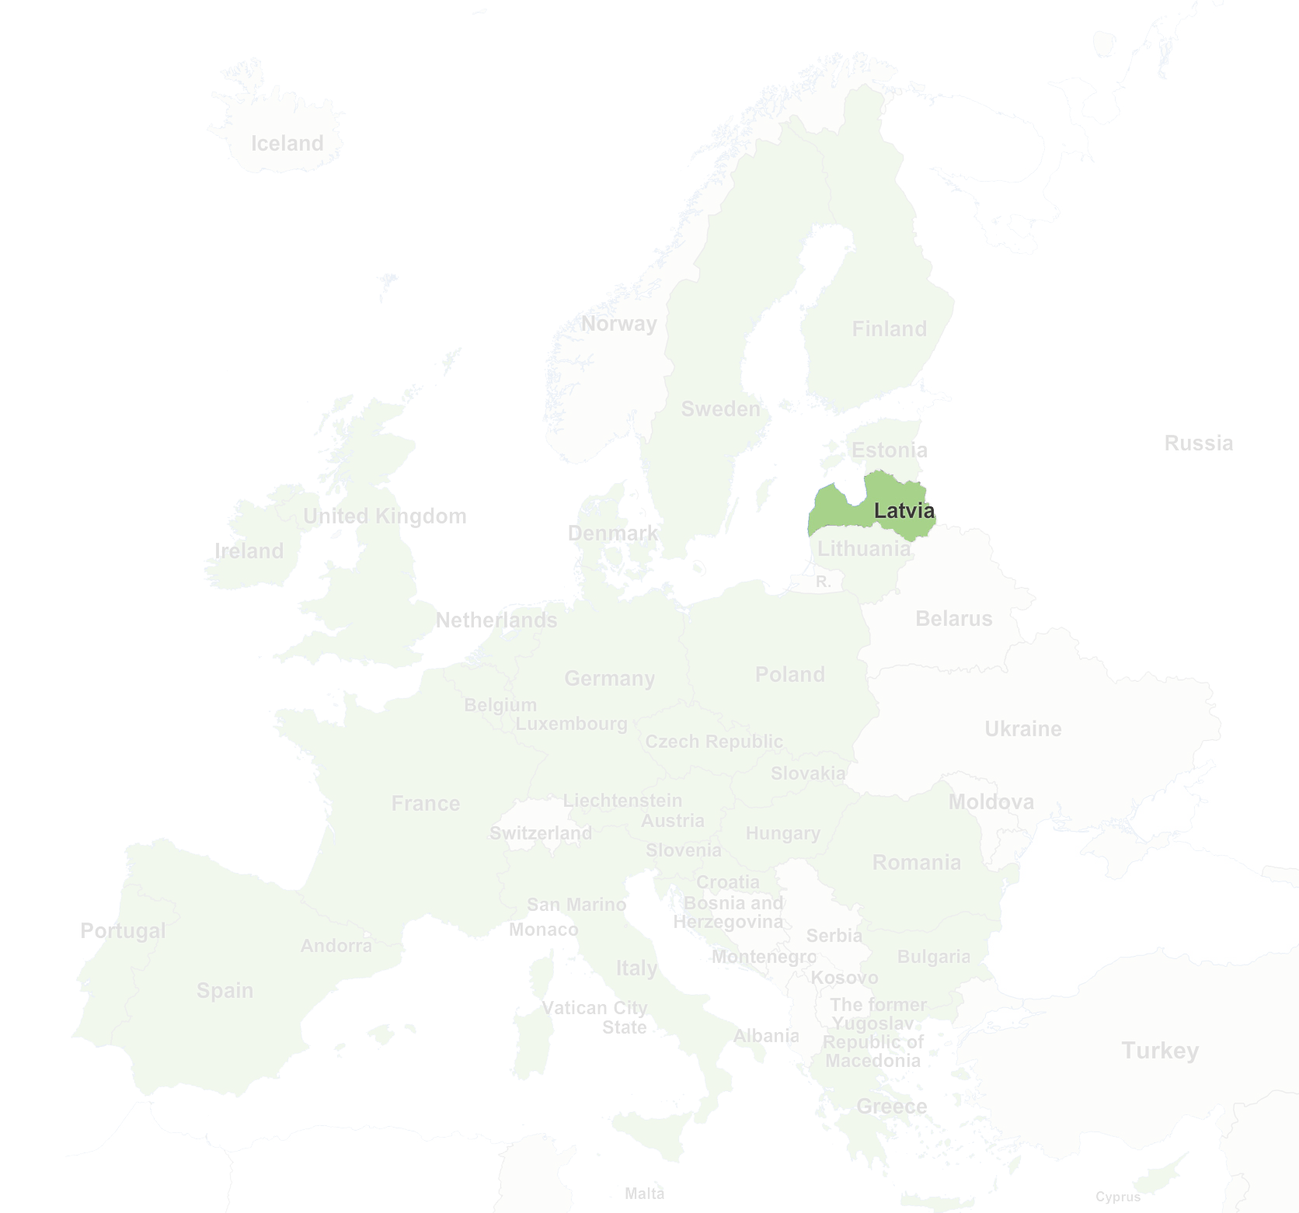
Latvia
Situated in Northern Europe, on the coast of Baltic Sea; Capital: Riga
Founded: November 18, 1918;
European Union: since 2004; Eurozone: since 2014;
Presidency of the Council of the European Union in 2015;
Annual GDP growth up to 4,5%;
Economy and exports: logistics, high-tech, chemicals, pharmacy, agriculture, woodwork
Population: 1 984 887 in 2016;
Ethnic composition: latvians 61.4%, russians 26%, belarusians 3.4%, ukrainians 2.3%, others;
Students: 85.9 thsd in 2015; Higher education institutions: 60
Notes:
Latvia exists as an independent country since 1918, with an interruption between 1940 and 1991 when it was incorporated in the Soviet Union. It has a number of HEIs (including colleges), out of which about 1/3 are state-founded.

Slide 4
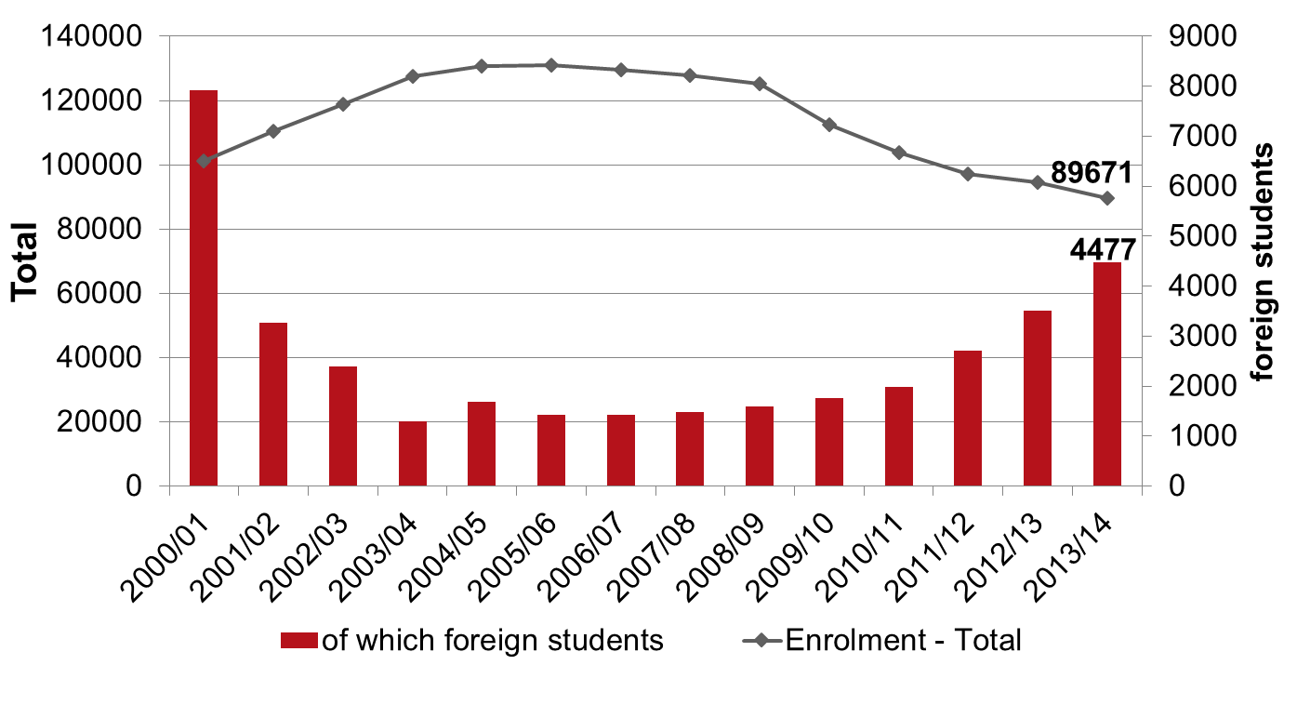
Number of all students and foreign students in HEI of Latvia, 1995 –2014
Based on data of Central Statistics Office of Republic of Latvia, 2016
Notes:
Since nineties the HEIs have been intensively developing their international contacts, including also recruitment of foreign students.

Slide 5
Number of foreign students in higher education institutions of Latvia by country of permanent residence, 2009–2014 (number of foreign students greater than 10 in 2013/14)
 | 2008/09 | 2009/10 | 2010/11 | 2011/12 | 2012/13 | 2013/14
Algeria | - | - | - | - | 7 | 11
United States | 8 | 14 | 13 | 17 | 28 | 32
United Kingdom | 28 | 30 | 33 | 31 | 41 | 52
Armenia | 10 | 15 | 14 | 6 | 9 | 12
Austria | 2 | 2 | 3 | 22 | 30 | 43
Azerbaijan | 5 | 13 | 22 | 44 | 97 | 125
Belarus | 60 | 57 | 66 | 91 | 107 | 171
Belgium | 2 | 3 | 4 | 8 | 10 | 12
Czech Republic | 9 | 10 | 34 | 26 | 15 | 40
Denmark | 1 | 3 | 4 | 13 | 12 | 14
South Korea | - | 3 | 6 | 13 | 14 | 18
Egypt | - | - | 1 | 18 | 21 | 19
France | 17 | 31 | 31 | 44 | 65 | 134
Georgia | 109 | 99 | 98 | 119 | 111 | 106
Estonia | 88 | 82 | 73 | 71 | 70 | 88
India | 9 | 5 | 8 | 10 | 94 | 149
Italy | 17 | 22 | 33 | 56 | 56 | 56
Israel | 14 | 14 | 14 | 9 | 8 | 14
Kazakhstan | 27 | 12 | 18 | 36 | 116 | 143
Russian Federation | 397 | 360 | 361 | 357 | 387 | 482
Chine | 12 | 2 | 11 | 11 | 9 | 13
Lithuania | 303 | 233 | 237 | 260 | 213 | 209
Republic of Moldova | 4 | 7 | 9 | 20 | 26 | 36
Nepal | 5 | 4 | 2 | 1 | 23 | 27
Netherlands | 1 | 2 | 4 | 13 | 25 | 35
Niger | 9 | 7 | 10 | 33 | 45 | 38
Norway | 30 | 48 | 78 | 101 | 132 | 133
Pakistan | 9 | 9 | 8 | 13 | 16 | 22
Poland | 19 | 31 | 39 | 57 | 58 | 54
Portugal | - | 6 | 5 | 16 | 28 | 37
Romania | 3 | 2 | 1 | 12 | 7 | 14
Slovakia | 1 | 1 | 5 | 4 | 18 | 22
Finland | 7 | 9 | 21 | 44 | 57 | 93
Spain | 21 | 26 | 48 | 126 | 97 | 106
Sri Lanka | 56 | 42 | 23 | 23 | 27 | 33
Tajikistan | 6 | 9 | 15 | 17 | 18 | 25
Turkey | 10 | 9 | 21 | 78 | 114 | 199
Ukraine | 61 | 259 | 214 | 183 | 188 | 233
Uzbekistan | 27 | 31 | 50 | 96 | 190 | 366
Germany | 98 | 109 | 155 | 370 | 567 | 746
Sweden | 34 | 57 | 86 | 117 | 165 | 197
Source: Central Statistics Bureau of Republic of Latvia, 2016
Notes:
As you can see from this table, students come also from partner countries of this project. The last available overall statistics qoute 143 from KZ and 366 from UZ

Slide 6
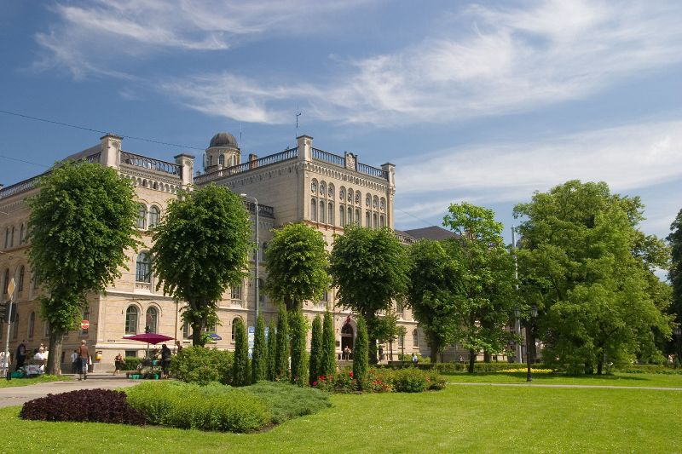
University of Latvia
Founded: September 28, 1919
Students: 13 055, 2016
QS World University Rankings 15/16: 651-700
Faculties: 13
Institutes: 12+3
Study programmes: 130 (undergraduate 53, postgraduate 53, doctoral 24)
Staff: 2283 (academic 1151, other 1132)
Opening of the new campus on September, 2015
Notes:
HE in Latvia existed since XIX century (Riga Polytechnic was established by Russian tsar’s decree in 1896). When with the end of the WW1 Latvia was established as an independent state, one of the 1st steps was to develop the National university. Over the years it has been largest or 2nd largest HEI in Latvia. In 1957 and 1958 some faculties split off to form new HEIs (by decision of Soviet government). After restitution of independency in 1991 and until present some of the faculties have been reestablished (such as Chemistry faculty in 1964. UL does not have engineering faculties (those are found in RTU, former RPI that split off in 1958 and for some period had developed into the largest HEI), but it has studies in medicine and pharmacy (in parallel to a separate large specialized university that developed starting with splitting off from UL in 1957 as the Riga Medicine Institute.
A new campus has started with the building of Natural sciences (including our faculty) in 2015

Slide 7
What is Quality?
Fitness for purpose (for product)
Meeting the needs/requirements of client (for services)
Notes:
A few words about notion of quality.
Definitions developed in the middle of the last century with quality management coming into fashion. This is just to show that one should speak of quality only in the context of functioning of the product or the service. Above all one should not compare products that have different usage or services designed for different clients. If we speak about HE we cannot say that its quality in a country like LV is higher or lower than in KZ or UZ unless we decided to have a common labour market (for which our HE is providing specialists, as one of the objectives).

Slide 8
Product and service in HE
Source material (totality of knowledge, skills and competencies of the applicant)

[Academic process (service)]

Product (totality of knowledge, skills and competencies of the graduate – “learning outcomes”)
Notes:
Why we can apply the definitions to HE at all. The fact is that academic process just as any production processes has certain source (raw) material that is developed (processed) into some product. The process itself can be considered as a service provided to those who benefit from the ‘product’. What makes HE (and education in general) different is that students are both as the ‘material’, ‘actors’, and the ‘main beneficiaries’. This should be born in mind when one speaks about students’ role in QA

Slide 9
Clients/stakeholders of the academic process
Internal | External
Students Colleagues Staff of further study stages Faculty management Institutional management … | Employers Graduates Government institutions Wider society HEIs abroad …
Notes:
What else makes academic process different from e.g. production of manufactured goods is that there is a number of persons or institutions who are concerned with the process or its result and are affected by it, students are the ones affected crucially, as already mentioned. Therefore it is complicated to find out the ‘requirements of the client’

Slide 10
Quality in a multi-client situation
Fitness for purpose Meeting the standards for ‘product’ | Professional standards/ Educational standards
Meeting the needs/requirements of client for ‘services’ Meeting the standards of the academic process | Standards and guidelines for quality assurance in European Higher Education Area (ESG)
Notes:
The solution in a multi-client situation is the requirements for ‘products’ and for ‘services’ have to be standardised (at National or European level)
There are National standards on bachelor, master and doctor studies as well as 1st and 2nd level professional studies adopted by Cabinet of Ministers between 2000 and 2014. ESG have been adopted by the Education Council of EU in 2005 and revised in 2014. And we should notice that standards can be developed both for products and services. The conviction is that having conformity with the standards for the academic process, we stand a high chance to ‘produce’ a quality ‘product’.

Slide 11
Various terms concerning quality
Quality assurance (QA)
Quality assurance system (QAS)
Quality management (QM)
Quality management system (QMS)
Quality audit
Quality assessment
Quality control
Quality culture
Notes:
Therefore, when we speak of quality asurance, we very much concentrate on the process of teaching and learning, bearing in mind, of course, that the ultimate goal is the educated person or – more precisely – his/her learning outcomes. This is done both in internal QA and in external QA (accreditation process). Apart from QA there are a number of other notions concerning quality, each of them with its own meaning and its usage. One of the most important is Quality management. By the way in most HEIs of the WE QM existed much before the accreditation. QMS is necessary as the framework to maintain and improve the QA. Internal QAS cannot be replaced by external quality control, because by its nature it can only concentrate on the product, not the process.

Slide 12
System

Slide 13
External requirements, and strategic objectives form the structure of QMS of UL… (from Order Nr.1/338 of 19.12.2012. “Process management in University of Latvia”)
Notes:
Quality policy defines continuous development towards excellence in research-based studies as the aim of Quality assurance system [of studies]. The model of excellence and Regulation on process management sets guidelines for building, assessment and development of the system of quality management of studies, an is represented in the model of electronic process management – LU QuPeRs. The regulation on process management has been adopted on 19.12.2012. LU order Nr.1/338)
Study processes are clearly structured and there are responsibles for each of them. Collective responsibility belongs to the decision-making bodies - Constitutional assembly, Senate, Committee of assessment of quality of study programmes (CAQSP), Faculty boards un Study programme councils (SPC); they evaluate study quality and decide on measures for ensuring the quality of studiies in UL. Administration of UL is responsible for functioning of quality management system and performs monitoring and audits of study process.
Regulation on CAQSP has been adopted on 17.03.2010. UL order Nr.1/66)
Regulation on SPC has been adopted on 25.05.2009. Senate decision Nr.248)
Regulation on Administration has been adopted on 21.09.2009. Senate decision Nr.33)

Slide 14
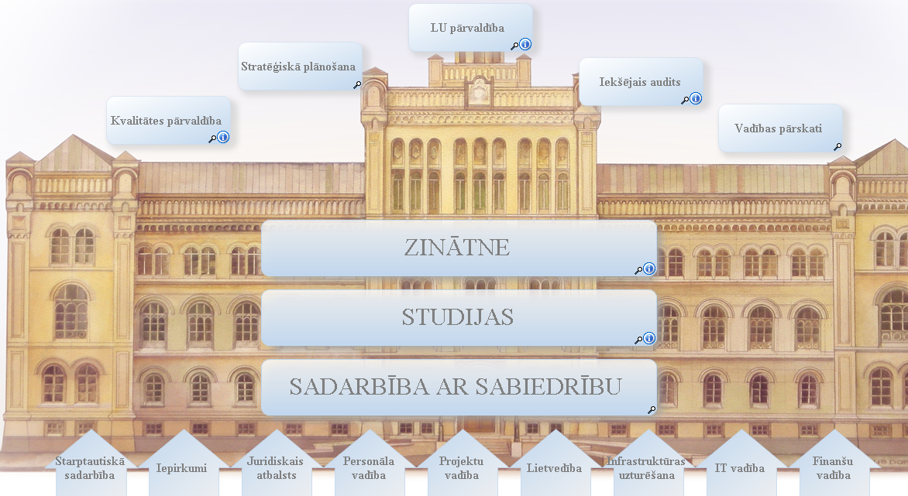
UL process management module

Slide 15
UL process management module - Structure
UL management
Strategic planning
Internal audit
Quality management
Administration reports
SCIENCE
STUDIES
INTERACTION WITH SOCIETY
International cooperation
Purchases
Staff management
Project management
Filing
Maintenance of infrastructure
IT management
Financial management

Slide 16
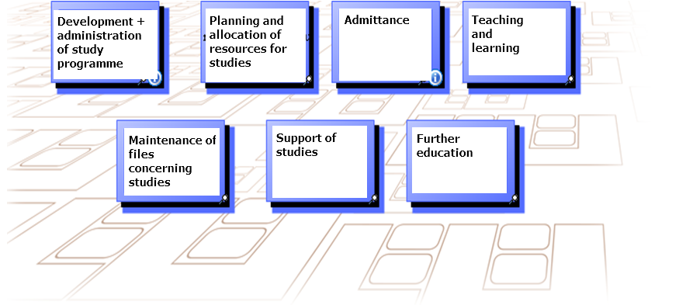
UL process management module - STUDIES

Slide 17
UL process management module – STUDIES : Teaching and learning

Slide 18
UL process management module - SCIENCE

Slide 19
UL process management module - / SCIENCE – Running the Science projects

Slide 20
UL process management module - / SCIENCE – administration of basic funding

Slide 21
Compliance with ESG

Slide 22
1.1. Policy and procedures for QA
Institutions should have a policy for QA that is made public and forms part of their strategic management. Internal stakeholders should develop and implement this policy through appropriate structures and processes, while involving external stakeholders.
Policies and processes are the main pillars of a coherent QA system … The policy has a formal status and is publicly available
Notes:
Now I will try to illustrate the internal QA in our institution.
Altogether there are more than 100 internal regulations concerning academic process, and most of them are directly or indirectly following the ESG, although not specifically referring to it. And we have to start with 1.1.

Slide 23
Basic directions of strategic development (Senate) Quality policy (Senate) On process management (Rector’s order) Scheme of system of documents of strategic management (Senate) On Committee of assessment of quality of study pr. (Rector’s order) Regulation of the Council of study programmes of UL (Senate) On regulation on academic and administrative staff positions (Senate) Regulation on payment for academic labour (Senate) On Directors of the study pr. (Senate) Duties and rights of the head of subprogr. of a study pr. (Rector’s order) (On descriptions of staff positions (Rector’s order) Regulation of Admnistration of UL (Senate) On organization of regular opinion polls on assessment of study process (Rector’s order) Rules on Academic honesty (Senate) Internal rules of order for students (Senate) On regulation of Committee of academic ethics (Senate) Order of considering the proposals and complaints (Rector’s order) Involvement of employers: Regulation of convent of counsellors of UL (Senate) Regulations of faculty boards (some that involve employers)

Slide 24
External requirements, and strategic objectives form the structure of QMS of UL… (from Order Nr.1/338 of 19.12.2012. “Process management in University of Latvia”)
Notes:
Quality policy defines continuous development towards excellence in research-based studies as the aim of Quality assurance system [of studies]. The model of excellence and Regulation on process management sets guidelines for building, assessment and development of the system of quality management of studies, an is represented in the model of electronic process management – LU QuPeRs. The regulation on process management has been adopted on 19.12.2012. LU order Nr.1/338)
Study processes are clearly structured and there are responsibles for each of them. Collective responsibility belongs to the decision-making bodies - Constitutional assembly, Senate, Committee of assessment of quality of study programmes (CAQSP), Faculty boards un Study programme councils (SPC); they evaluate study quality and decide on measures for ensuring the quality of studiies in UL. Administration of UL is responsible for functioning of quality management system and performs monitoring and audits of study process.
Regulation on CAQSP has been adopted on 17.03.2010. UL order Nr.1/66)
Regulation on SPC has been adopted on 25.05.2009. Senate decision Nr.248)
Regulation on Administration has been adopted on 21.09.2009. Senate decision Nr.33)

Slide 25
1.2 Design and approval of programmes:
Institutions should have processes for design and approval of programmes. The programmes are designed so that they meet the objectives set for them, including the intended learning outcomes. The qualifictaion resulting from a programme should be clearly specified and communicated, and refer to the correct level of the NQF, and consequently to the framework for qualifications of the EHEA.
Notes:
The study programme level will be dealt specifically with my colleague Anda Prikšāne; here I will just mention what is done in this respect at the central management level.
Regulations on Directors of Study programmes, Heads of sub-programmes, Staff descriptions, Regular electronic polls for evaluation of studies are also adopted at central level (Senate or Rector). The same concerns development and revision of study programmes and individual courses.

Slide 26
Regulation on standard of 1st level professional HE (Cabinet of Ministers) Regulation on standard of 2nd level professional HE (Cabinet of Ministers) Regulation on standard of 2nd level professional HE (Cabinet of Ministers) Order of evaluation and adoption of stud.pr. (Senate) On Committee of assessment of quality of study pr. (Rector’s order) On requirements on preparation of annual reports on study domains (Rector’s order) Regulation of the Council of study programmes of UL (Senate) Basic directions of strategic development (Senate) On regulation on academic and administrative staff positions (Senate) Rules on Directors of the study pr. (Senate) Duties and rights of the head of subprogr. of a study pr. (Rector’s order) On organization of regular opinion polls on assessment of study process (Rector’s order) Constitution of UL (Constitutional Assembly, Cabinet of Ministers )

Slide 27
Description of internal QAS of a STUDY DOMAIN
Notes:
This diagram demonstrates how we approach the study domain. (It has to be mentioned that since 2011 we – in LV – have switched in accreditation from individual study programmes to study domains, i.e. The set of all SP in each study domain, e.g., Bachelor, Master and Doctor SP in Chemistry).

Slide 28
Evaluation and adoption of a study programme
Notes:
Here we can view the algorithm of the process of evaluation and adoption a separate study programme, starting with preparation of the self-evaluation report and ending with its implementation or closure (depending on the results).

Slide 29
1.3 Student-centered learning, teaching and assessment:
Institutions should ensure that the programmes are delivered in a way that encourages students to take an active role in creating the learning process, and that the assessment of students reflects this approach.
Notes:
Student assessment is done at the level of study programme or individual course, but again, the procedures are definmed at the central level.

Slide 30
On requirements for preparation and renewal of study courses (Rector’s order)
On types and forms of studies (Rector’s order)
Regulation on individual plans of studies (Rector’s order)
Internal rules of order for students (Senate)
On organization of studies of foreign languages (Rector’s order)
On organization of e-studies (Rector’s order)
On practical placements in academic study pr. (Rector’s order)
Order of registration and accounting of attendance (Rector’s order)
Regulation of Council of study programmes of UL (Senate)
Regulation on student advisors of UL (Rector’s order)
Order of interrupting of studies in UL (Senate)
Order of considering the proposals and complaints of students (Rector’s order)
Order of organization of course examinations (Senate)

Slide 31
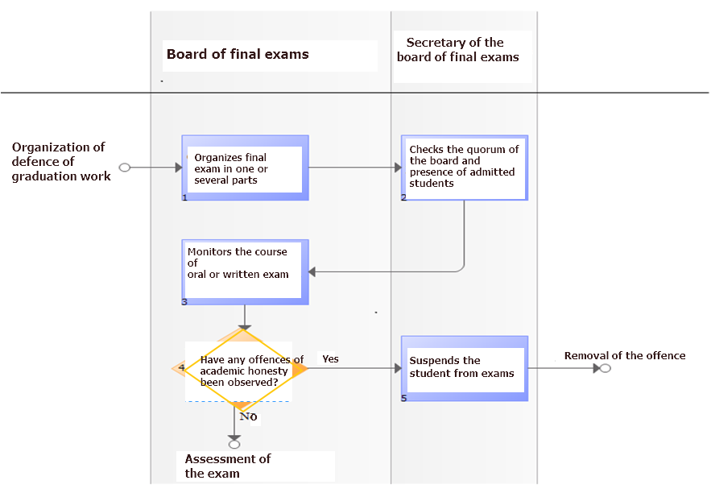
ORGANIZATION OF FINAL EXAMS (QuPeRs)
Notes:
This is an illustration of the process final exams or defence of the graduation work. In each such process we can notice the sequance of actions and the responsible persons or units to do them. You can notice here also the notion of ‘academic honesty’ and how it is dealt with. (It does not show, but, e.g., we have a special software to analyze the presented theses on the subject of plagiarism.)

Slide 32
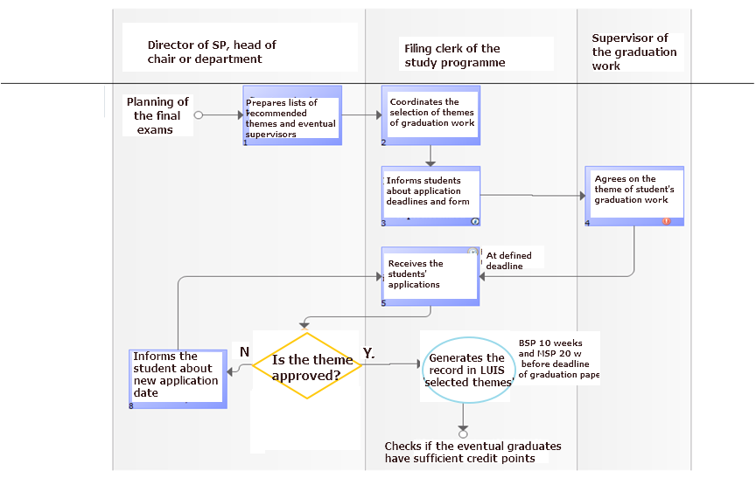
ADOPTION OF THEMES OF GRADUATION WORKS (QuPeRs)
Notes:
A special procedure has been defined for selection of topics and supervisors for graduation works. This concerns Bachelor and Master studies (the doctoral studies are by nature more individual and the topic and the supervisor are known already at the moment of enrolment).

Slide 33
1.4 Student admission, progression, recognition and certification:
Institutions should consistently apply pre-defined and published regulations covering all phases of the student life-cycle, e.g. student admission, progression, recognition and certification.
Notes:
Student assessment is done at the level of study programme or individual course, but again, the procedures are definmed at the central level.

Slide 34
Law on HEIs (Parliament)
Regulation on Enrolment Procedure at the University of Latvia (Senate)
Order for admittance in UL for acad.year 2016/2017 (Rector’s order)
Regulation of admittance committee of UL (Rector’s order)
Agreement on studies in UL (Rector’s order)
Order of organization of course examinations (Rector’s order)
On organization of studies of foreign languages (Rector’s order)
On organization of e-studies (Senate)
On practical placements in academic study pr. (Rector’s order)
On organization of regular opinion polls on assessment of study process (Rector’s order)
Regulation on academic honesty (Senate)
Internal rules of order for students (Senate)
On regulation of committee of academic ethics (Senate)
Information on admittance at all the cycles is published at the internet site for applicants
Study results are accounted and maintained in the portal of e-studies):
On change of medium of e-studies (Rector’s order)
On organization of e-studies (Rector’s order)
Regulation on assessment and recognition of previous study achievements based in previous studies or practical work (Senate)
Order of organization of mobility funded from financial instruments of European Economic Area and Norway (Rector’s order)
Order of interrupting the studies in UL (Senate)
On collecting of questionnaires from those who proposed to interrupt their studies (Rector’s order)

Slide 35
1.5 Teaching staff: Institutions should assure themselves of the competence of their teachers. They should apply fair and transparent sprocesses for the recruitment and development of the staff.
Notes:
Teaching staff is one of the crucial things in the academic process, and certain requirements have been established at the National level. Inter alias, there are certain requirements for proportion of staff having academic and scientific degrees, according to National typology of HEIs. Apart from that we have internal regulation on staff. A specific procedure has been defined for election of staff.

Slide 36
Basic strategic directions of LU (Senate) On Regulation for academic and administrative staff positions (Senate) Regulation for payment for academic labour (Senate) Regulation on Direcors of study programmes (Senate) Duties and rights of Head of subprogram of a Study programme (Rector’s order) On descriptions of staff positions (Rector’s order) Regulation on Administration of UL (Senate) Research programme 2015–2020 (Senate) On organization of mobility funded from financial instruments of EEA and Norway (Rector’s order)

Slide 37
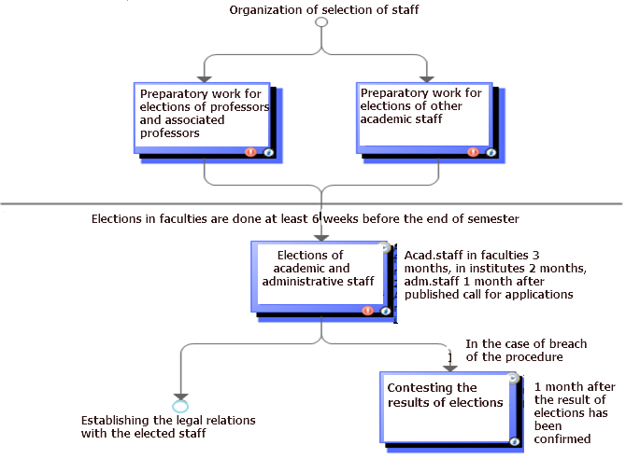
ORGANIZATION OF STAFF ELECTIONS (QuPeRs)
Notes:
It has to be mentioned that staff has to be elected (or re-elected) on a regular basis, and each time there is an open competition for the position. Only in very specific cases a member of academic staff can be established in his/her position just be rectoral decree; this can be done only for the period of 1 year.
The regulation of our institution foresees that before the election, the performance of the candidate is evaluated by colleagues and students (in case of repeated election); if the person is new, he/she is requested to deliver a class on a given topic from one of the prospective courses, and the evaluation is based on this lecture, seminar or such like.

Slide 38
1.6 Learning resources and student support: Institutions should have appropriate funding for learning and teaching activities and ensure that adequate and readily accessible learning and student support are provided.
Notes:
The main resource is the forms of teaching and learning provided at the SP and individual level. At he institutional level we have a number of support forms that are maintained adminstratively and financially from the institutional budget.

Slide 39
Basic strategic directions of UL (Senate) Language policy of UL (Senate) Regulation on Sports games of UL (Rector’s order) Research programme 2015–2020 (Senate) Library (…)

Slide 40
Notes:
One of very important – centrally managed – support forms is the institutional library. This and a few more slides are copies from internet pages of our university.

Slide 41
Notes:
Here one can see the page on resources. There is a number of branches of the library, because we have the faculties scattered around the city. However the catalogues can be approached remotely, and the books can be ordered from any branch and delivered to the nearest one to the student. Apart from books and magazines there are vast electronic resources.

Slide 42
Notes:
In this page I have copied the list of resources in chemistry in electronic form. Most of them are with open access, but the ones locked can be accessed with a password students get free of charge (along with a free copy of MS Office during their studies).

Slide 43
Notes:
An important resource, also maintained centrally is the electronic system MOODLE, available to students and staff and containing most (nearly all) courses that are being delivered.

Slide 44
1.7 Information management:
Institutions should ensure that they collect, analyse and use relevant information for the effective management of their programmes and other activities.
The information gathered…: Key performance indicators Profile of the student population Student progression, success and drop-out rates Students satisfaction with their programmes Learning resources and student support available Career paths of graduates
Notes:
As concerns the information systems, they are also maintained centrally and used by students and academic and administrative staff to store, manage and use the relevant information.

Slide 45
External requirements, and strategic objectives form the structure of QMS of UL… (from Order Nr.1/338 of 19.12.2012. “Process management in University of Latvia”)
Notes:
The main system is LUIS (information system of UL), and it contains all the personal data on students and staff (accessible only in an authorised way so as to meet the requirements of the law on protection of personal data. But it also contains all the records concerning the academic process, and the student can always find out what tasks or tests he has to perform and what is his/her situation with the academic progress. Here also the students can approach centrally organized questionnaires to leave their opinion on programmes, courses and their staff. These opinions are used, i.a., for election of staff and for renewal or amendment of programmes and courses.

Slide 46
Information is accumulated, maintained and processed in LUIS. Information is stored and treated by Data storage unit
Basic strategic directions of UL (Senate)
Research programme 2015–2020 (Senate)
Annual public reports

Slide 47
1.8 Public information:
Institutions should publish information about their activities, including programmes, which is clear, accurate, objective, up to date, and readily accessible.
Notes:
The university makes its information available to public mostly electronically (via internet), but there also regularly renewable leaflets on faculties and programmes distributed in information events. There are also periodical publications about faculties and the university in a format of books, also containing quantitative data about the programmes and awards. (2 years ago, by the way, we completed and published a book about 50 years of Chemistry Faculty, containing a chapter on current SP).

Slide 48
Internet site in 3 languages Law on HEIs => Annual public reports Information published at Faculty web-sites on study programmes and also annual self-evaluation reports Carriere days organized by Carriere centre Portal “Alumni of UL Center for media and marketing (up-to date information) Basic strategic directions (Senate) Research programme 2015–2020 (Senate) Order on registration and accounting of attendance (Rector’s order)

Slide 49
Notes:
In the internet one has special pages for those who would like to study in our university, and theses pages have concise information on programmes and courses

Slide 50
Notes:
When one enters particular programme, one can see all the basic data about the programme, and also the annotation and the description of aims and tasks of the programme.

Slide 51
Notes:
Information is also available in English, only in a different format, because it is meant for foreigners and not all the study programmes have been duplicated in English. The page about admission contains useful tips and advice on how to become our student.

Slide 52
Notes:
Particular study programmes have a general description in English – as you can see from our Bachelor programme in Chemistry, with attachments containing more detail.

Slide 53
1.9 On-going monitoring and periodic review of programmes:
Institutions should monitor and periodically review their programmes to ensure that they achieve the objectives set for them and respond to the needs of students and society. These reviews should lead to continuous improvement of the programme. Any action planned or taken as a result should be communicated to all those concerned
Notes:
The university makes its information available to public mostly electronically (via internet), but there also regularly renewable leaflets on faculties and programmes distributed in information events. There are also periodical publications about faculties and the university in a format of books, also containing quantitative data about the programmes and awards. (2 years ago, by the way, we completed and published a book about 50 years of Chemistry Faculty, containing a chapter on current SP).

Slide 54
On evaluation and adoption of SP (Senate)
Regulation on Committee of evaluation of quality of SP (Rector’s order)
On requirements for preparation of annual reports of study domains (Rector’s order)
Plan of action for improvement of processes after the audit (Rector’s order)
On collecting the questionnaires from those who propose interrupting of studies (Rector’s order)

Slide 55
1.10 Cyclic external quality assurance:
Institutions should undergo external quality assurance in line with the ESG on a cyclic basis
…institutions ensure that the progress made since the last external QA activity is taken into consideration when preparing for the next one
Notes:
The university makes its information available to public mostly electronically (via internet), but there also regularly renewable leaflets on faculties and programmes distributed in information events. There are also periodical publications about faculties and the university in a format of books, also containing quantitative data about the programmes and awards. (2 years ago, by the way, we completed and published a book about 50 years of Chemistry Faculty, containing a chapter on current SP).

Slide 56
Regulation on accreditation (Cabinet of Ministers) => annual reports of study domains are prepared On requirements for preparation of annual reports of study domains (Rector’s order) Order of evaluation and adoption of study programmes (Senate) On Committee of evaluation of quality of study programmes (Rector’s order) Self-evaluation reports of study domains are published in internet sites of faculties ESG

Slide 57
«International Economics and Commercial Diplomacy»
Bachelor Program: Implementing Learning Outcomes
INTRODUCTORY PART: terminology
PRACTICAL PART: case study
What should be the goal of my lecture?

Slide 58
Learning Outcomes
What are learning outcomes?
https://dspace.lu.lv/dspace/bitstream/handle/7/5101/20561-Agnese_Rusakova_2011.pdf?sequence=1

Slide 59
Agnese Rusakova
D.sc.admin. in Educational Management
Lecturer,
Faculty of Economics and management,
University of Latvia
Expert at
Latvian Rector’s Council
National EACEA expert for validation of nonformal and informal learning
15 years International Coordinator at the University of Latvia
France: Exchange student
Spain: Research fellowship
USA: Internship
Germany: Internship, Exchange student, M.sc.MM
Born in 5 kids family, loves understanding world and hates tenting
Germany: Internship, Exchange student, Master degree M.sc.MM
Poland:
Freelance translator from Polish to Latvian
Mom of three kids

Slide 60
Learning outcomes = quality tool
transparent, clearly set responsibility, target-oriented, student centered, structured, resources [time, student and lecturer workload]-saving
-> quality
Bologna process requires to
decrease study period!
ILLUSTRATIVE info
PERIPHERAL sciences
CORE
Learning
outcomes
the lecturer might change,
but the core knowledge
that the students get taught
within the course
stay the same

Slide 61
KVS 1
What is student centered learning?
You all expect to LEARN something from this seminar.
Learning requires your active engagement with the subject.
My role is to guide You through the learning process.
I do not know everything and expect to learn from You too!
Learning is the activity of learners = your own responsibility
responsibility on quality of learning is divided!
Who is our student?
Week 1

Slide 62
What could I do,
to ensure that this my presentation
is «student centered» -
e.g. complies with your needs?

Slide 63
strategy
student body nowadays becomes more and more diverse (life long learning, mobility, access to information);
dynamic and global labour market: employers look rather for adaptation skills than for fundamental knowledge;
interrelation and interdependency creates pressure for accountability;

Slide 64
What could I do,
to ensure that this my presentation
is «student centered» -
e.g. complies with your needs?
feedback is crucial
I am not a lecturer, but a mere team member,
that facilitates reaching the goal-
understanding Learning Outcomes concept
no hierarchy of knowledge visible
Therefore the question -who is our student?

Slide 65
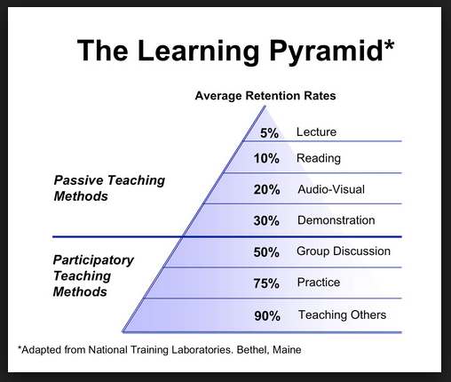
Millenials and Generation Z at learning
Millennial characteristics vary by region, depending on social and economic conditions. There's a marked increase in use and familiarity with communication, media, and digital technologies. In most parts of the world its upbringing was marked by an increase in a neoliberal approach to politics and economics.
Generation Z is highly connected, having had lifelong use of communication and media technology like the World Wide Web, instant messaging, text messaging, MP3 players, and mobile phones, earning them the nickname "digital natives".
Who is our student?
what we learn and remember 2 weeks later
How does
student learn?
1960s

Slide 66
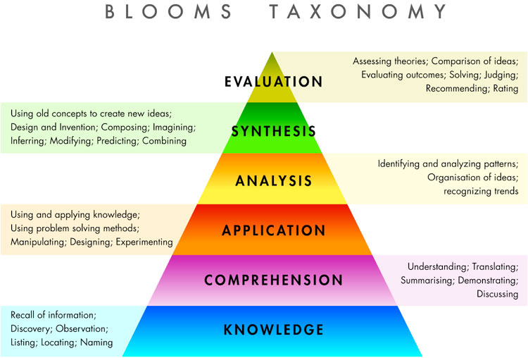
What is the relation between
Bloom’ s taxonomy and Learning Outcomes?
?

Slide 68
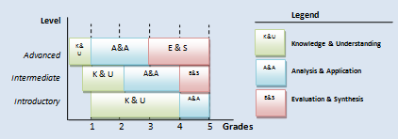
Bachelor vs. Master vs. Doctoral level

Slide 69
FIRM
BAKERY
Knowledge of the ’resources’ of the firm;
Understanding which services these resources can render;
Analytical skill to figure out what is happening in the firm’s task environment;
Application of all above to organise one’s mindset to ’create’ own industry;
Use of all above to evaluate environmental & extra-environmental opportunities;
Synthesis of all above to generate value creating strategies.
Knowledge bread consists of water and flour;
Understanding bread is quite nutritional;
Analytical skill to figure out that there are people that would like to eat less, but providing more energy;
Application of all above to start baking pastries;
Use of all above to evaluate the number of people buying bread and pastries and the related business costs;
Synthesis of all above to switch to baking pastries only.
LEARNING OUTCOMES
ASSESSMENT

Slide 70
Achievement of learning outcomes should be evidence based
ASSIGNMENT/assessment
sell a clearly wrong idea to fellow students
find solution to the problem by providing a list of possible actions
write critical review, using references to theory
teach your colleague student a chapter of theory
read titles of newspaper articles and consider future business opportunities
on basis of some article prepare reports for 2 different target auditoriums
read scientific article and guess 5 keywords, create a title, annotation to an article, twitter the article
case study
OBJECTIVE/learning outcome
scientific polemics
managerial skills
explain and justify own viewpoint in a written form
pedagogic skills
idea generation skills
explain professional issues both to specialists and non-specialists
understand the essentials
evaluate the trustworthiness of the information source
Please create a sentence using terms: «learning outcomes», «accountability»

Slide 71
Learning outcomes = quality tool
T______rent, clearly set resp_____ility, __rget-orie____d, student cent____, stru___red, r_____es [time, student and lecturer workload]-saving
-> q_____y
Bologna process requires to
decrease study period!
ILLUSTRATIVE info
PERIPHERAL sciences
CORE
Learning
outcomes
the lecturer might change,
but the core knowledge
that the students get taught
within the course
stay the same

Slide 72
Administrative support
Workshops/seminars on learning outcomes concept
Concept introduced in internal normative acts (e.g. procedure of course assessment; statute of the programs; recognition of prior learning based on learning outcomes)
Program and course description amended accordingly in LUIS; descriptions undergo quality check
Infrastructure and tools (e.g. e-Studies) for promoting feedback to students (formative and summative learning)

Slide 73
Program outcomes
vision
on the program’s
graduates skills,
competencies, attitudes
This vision is fulfilled by
targeted actions
towards learning
outcomes of individual
courses
…
to prepare highly qualified specialists who work in state, private and international institutions, comprehend issues of international economy and commercial diplomacy, are able to take independent decisions, handle everyday tasks and cooperate with Latvian and foreign organizations, offices and enterprises
…

Slide 74
Learning outcomes of the SP
Cycle descriptors, qualification descriptors (Occupational Standards)
Choice of taxonomy - Benjamin Bloom’s taxonomy, SOLO (John Biggs), taxonomy in psychomotorous domain (Dave)
Tuning project results
Top down approach (a brand new program created)
Holistic approach (program outcomes determine the content and NOT vica versa)
Quality tool- all lecturers involved in formulating the learning outcomes
Stakeholders: employers involved in formulating the learning outcomes and students consulted

Slide 75
Competences, skills, attitudes | Cycle descriptors of NQF: Bachelor programs | Learning outcomes of the program
Knowledge and understanding | · demonstrate comprehensive and specialized knowledge and understanding of the facts, theory, causalities, technologies of the respective professional field | Demonstrate the understanding of the actual processes in international economy, commercial diplomacy, as well as policy science, culture and law;
Ability to apply knowledge | · based on analytical approach, perform practical tasks in the respective profession · demonstrate skills of creative problem solving
Analysis, synthesis, assessment | · independently extract, select, analyze and apply the information ; take decisions and solve problems in the respective academic and professional study field; comprehend professional ethics · assess the impact of own professional activities upon the environment and society | Analyse and assess these processes, by using statistical, econometric, as well as other quantitative and qualitative analytic methods and apply the results for improvement of company and institution, understanding the significance of the professional ethics in international business environment
Communication | · formulate and analytically describe the information, problems and solutions in own academic and professional study field, to discuss and provide arguments regarding practical issues and solutions to both experts and non-experts | Defend national or corporative interests in international trade, finance or other economic activities, be active in different institutions of both national and international level of action, as well as in local, private, governmental and multinational companies and corporations, being fluent in several foreign languages
Further learning | · with an appropriate degree of independence, to engage in further learning; improve one’s own actions and those of other people | Orientate in sources of knowledge (linked to the processes of international economy and commercial diplomac), especially knowing the development trends in leading economies of the world, problems of foreign investment and export promotion
Other general skills | · demonstrate understanding of the place of the profession in a broader social context · to work in co-operation with others, to plan and to organise work or to supervise such work activities, in which unpredictable changes are possible | Apply the presentation skills and scientific polemics, team working skills, be able to apply theory of the study field in both hypothetical and real situations

Slide 76
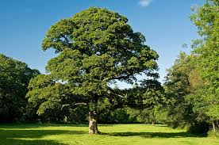
Learning outcomes of courses
Derived from the program outcomes
Choice of taxonomy – Benjamin Bloom’s taxonomy, SOLO (John Biggs), taxonomy in psychomotorous domain (Dave)
Tuning project results
Quality tool- all lecturers involved in formulating the learning outcomes
Stakeholders: employers involved in formulating the learning outcomes and students consulted
LO EQF/NQF -> LO program -> LO courses

Slide 77
roadMAP
learning outcome (aim) ->
-> teaching methods (how to achieve?) ->
-> assessment tools (did we achieve?) ->
-> course (responsible lecturer/-s)

Slide 78
Competences, skills, attitudes | Cycle descriptors of National Qualification Framework for Bachelor programs | Program outcomes
Knowledge and understanding | · demonstrate comprehensive and specialized knowledge and understanding of the facts, theory, causalities, technologies of the respective professional field | Demonstrate the understanding of the actual processes in international economy, commercial diplomacy, as well as policy science, culture and law;
Ability to apply knowledge | · based on analytical approach, perform practical tasks in the respective profession · demonstrate skills of creative problem solving
Analysis, synthesis, assessment | · independently extract, select, analyze and apply the information ; take decisions and solve problems in the respective academic and professional study field; comprehend professional ethics · assess the impact of own professional activities upon the environment and society | Analyse and assess these processes, by using statistical, econometric, as well as other quantitative and qualitative analytic methods and apply the results for improvement of company and institution, understanding the significance of the professional ethics in international business environment
Communication | · formulate and analytically describe the information, problems and solutions in own academic and professional study field, to discuss and provide arguments regarding practical issues and solutions to both experts and non-experts | Defend national or corporative interests in international trade, finance or other economic activities, be active in different institutions of both national and international level of action, as well as in local, private, governmental and multinational companies and corporations, being fluent in several foreign languages
Further learning | · with an appropriate degree of independence, to engage in further learning; improve one’s own actions and those of other people | Orientate in sources of knowledge (linked to the processes of international economy and commercial diplomac), especially knowing the development trends in leading economies of the world, problems of foreign investment and export promotion
Other general skills | · demonstrate understanding of the place of the profession in a broader social context · to work in co-operation with others, to plan and to organise work or to supervise such work activities, in which unpredictable changes are possible | Apply the presentation skills and scientific polemics, team working skills, be able to apply theory of the study field in both hypothetical and real situations

Slide 79
The lecturer/-s of which course will be responsible for the achievement
of the learning outcome?
Analyse and assess these processes, by using statistical, econometric, as well as other quantitative and qualitative analytic methods
Economic informatics I, Economic and business statistics
... apply the results for improvement of company and institution ..
Theory of Management, International Economics
... understanding the significance of the professional ethics in international business environment
Economics and World’s Security, Comparative Analysis of World’s Regions, Intercultural Environment

Slide 80
Learning outcome: the graduate is able to.. | how to achieve? ; how to assess? | who will be resopnsible?
..find solutions providing list with possible actions | case study; defence | World’s Religions
..conduct focus group interview and based on results formulate recommendations for improvement | focus group interview; report | ?
..organize work of middle sized group | teamwork on a project; report | ?
Quality tool!!!
Do our graduates really know how to work in teams or just seem to know?
Do the lecturers know the principles of organizing teamwork that other lecturers
follow? Maybe it is worth deciding which lecturer will allow students form
groups according to their preferences and which lecturer will form groups
according to some pattern (e.g. good students in pairs with less diligent ones)?

Slide 81
«International Economics and Commercial Diplomacy»
Bachelor Program: Implementing Learning Outcomes
LO EQF/NQF -> LO program -> LO courses
INTRODUCTORY PART: terminology
PRACTICAL PART: case study
Did we reach the goal of my lecture?

Slide 82
Did we reach the goal of my lecture?
IQAT project
- Uni of Latvia strategy of internal quality assurance;
- examples of internal quality management
exploitable for UZ HEIs structured by ESG;
strong and weak points;
recommendations for UZ
What are you able to do with the information from this session?

Slide 83
RECOMMENDATIONS

Slide 84
Building upon the existing system
What is impossible
What already exists but has to be ammended/improved
What additional parts might/should be added to fill the gap

Slide 85
Impossibilities
[Lack of] Autonomy of HEIs
National context (Bologna, NQF)
Structure of the institution (?)
But:
not everything that is defined at National level is to be considered as an obstacle

Slide 86
Amendments/Improvements
Visibility/publicity
Internal regulations/supporting documents
Formalization (Processes, Learning outcomes)
Self-evaluation

Slide 87
Additions
Expand the existing information
Involvement of students
Involvement of faculties
Involvement of external stakeholders

Slide 88
Further reference material

Slide 89
Study Program Development
Each program has defined the main aim and study results which correspond to the level of the awarded degree (bachelor, master, doctor or others) and determined by the needs of employers and society.
From MSc program LU:
The aim of the Program of Master studies in Chemistry is to provide students with deepened theoretical knowledge, practical skills and research abilities in the main areas of chemistry and in one of the chemistry sub-disciplines relevant to the needs of the labour market and access to the Doctoral studies.

Slide 90
Learning Outcomes for Master degree in chemistry
Second cycle degrees in chemistry are awarded to students who have shown themselves by appropriate assessment to:
- have knowledge and understanding that is founded upon and extends that of the Bachelor’s level in chemistry, and that provides a basis for originality in developing and applying ideas within a research context;
- have competences which fit them for employment as professional chemists in chemical and related industries or in public service;
- have attained a standard of knowledge and competence which will give them access to third cycle course units or degree programmes.
(«Chemistry Euromaster» http://chemistry-eurolabels.gandi.ws/)

Slide 91
Detailed Learning Outcomes of the Study Programme
Chemistry-related cognitive abilities and practical professional skills:
(for example, ability to integrate and apply chemistry knowledge and experimental and problem solving skills and formulate judgements in complex situations and in a new or unfamiliar environment…..
General skills:
(for example, ability to take responsibility for own professional development in chemistry or related fields and to continue self-organized learning…….
:
Notes:
Each employer can select young specialists looking at the outcomes and competencies defined for the graduates of the program. It does not work today properly, but anyway it is some kind of “the face” of the program

Slide 92
SP design has the following steps
definition of academic and professional profiles, translation into learning outcomes, incl. generic and subject specific competences,
translation into curricula,
translation into modules and approaches towards teaching, learning and assessment,
program quality assurance built in monitoring, evaluation and updating procedures.
Notes:
The first point we have already discussed. The second step is the development of curricula. The study courses and their outcomes have to form and fit into the general outcomes of the program. The appropriate teaching/learning methods have to be selected to reach the goals. For example, MSc graduates are able to do research, for that several research projects are carried out with in study courses.

Slide 93
Learning Outcomes of the study courses
The outcomes are defined also in each study course and they form the outcomes of the program.
Program level outcomes | Course level outcomes | Performance criteria
be able to plan, perform, explain and report experiments | Experimental part is enclosed in more than 10 study courses, (experiments in organic chemistry, analytical chemistry etc.) | -analyses, interprets and derives information from data etc.
 | Experiment planning is performed in Course project and in Bachelor Theses | -conducts a literature search and critically evaluates material, -selects method and equipment, -plans experiments,
Notes:
Here is one simplified sample. One study course as you can see further contains more than one outcome and they are more specific.

Slide 94
Self-assesment Report
between accreditations such report is prepared after each academic year,
it is prepared by the program director in cooperation with academics, representatives of students’ council and employers,
at first Self-assessment report is approved by Faculty councils,
next step is Quality assurance committee of the University,
finally it is approved by the University Senate.
Notes:
The students’ and emploers’ representatives are members of Chemistry Study program council (in the Faculty).

Slide 95
What has to be demonstrated and evaluated in the Self-assessment report?
data on students’ number and results (1-st year students (entrance score), graduate results, drop-out level, etc.) which demonstrate the demand of the program and students’ interest,
course content in line with the needs of labour market and society and with the achievements in the appropriate science field,
qualification of academc staff and program resourses,
students’ satisfaction with study courses and teaching methods,
employability of graduates and employers’ satisfaction with graduates,
SWOT analysis and plan of development and maintenance of the program to ensure the sustainability of the program.

Slide 96
Example of SWOT analyses
Strong points | Weak points
Program is implemented by qualified academic staff; Popularity and number of students of the program is rather stable; The ESF funding which has been obtained and used to the modernization of studies in 2007 and 2008, serves as a basis for quality improvement throughout the reporting period; Relatively wide labour market for graduates; Good cooperation with research centers, industry and employers; Stable traditions of scientific research; | Renewal of the academic staff is slow and uneven; Low number of exchange students; Academic staff participation in exchange programs is increasing slowly; It is difficult to make long-term planning of development of infrastructure and staff without financial perspectives for the coming years;
Opportunities | Threats
Active participation in the projects of local and European funds provides an opportunity to improve resources for the program. Enhancement of cooperation with foreign universities; Opportunities to study abroad as part of various mobility programmes; Development of study courses in English. | Solid average age of the academic staff; Reduction of funding for scientific development from Latvian sources; Deterioration of demographic situation of Latvia. Growing competition in the European market.

Slide 97
Various types of surveys used to get the feedback
Survey of graduates about all the program (filled after defence of graduation work),
Survey of Students after each study course (after each session) – evaluation of teachers’ performance, assessment and content.
Survey of employers (once in three years period)- quality of graduates and future requirements,
Survey of alumni (once in three year period)- alignment with the labour market

Slide 98
The Example of the Survey of Graduates (part of statements)
General | Resources | Process | Results
In general I am satisfied with the choice of this study program | Studies have appropriate material technical backup (rooms, computers and internet access) | In general satisfactory offer, contents and sequence of study courses in the study program | I acquired good theoretical and practical knowledge in my studies
Degree of difficulty of the study program was adequate for me | Responsive and available administrate staff | In general satisfactory offer of e-courses | During my studies I developed ability to take complex decisions evaluating information critically
Study program prepared me for further carrier development | Relevant resources offered by library of UL | The necessary information on study process easily available | During my studies I upgraded my communication skills
 | Good organization of study activities | Opportunities for international experience offered by UL were sufficient | I developed skills to apply my knowledge in practical activity
Scale: 1-completely disagree, 2-mostly disagree, 3-rather disagree, 4-neutral, 5-rather agree, 6-mostly agree, 7-completely agree

Slide 99
Example with development and assessment of a new study course
Notes:
The further slides are devoted to development and assessment of individual courses.

Slide 100
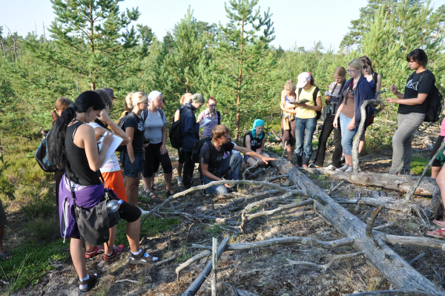
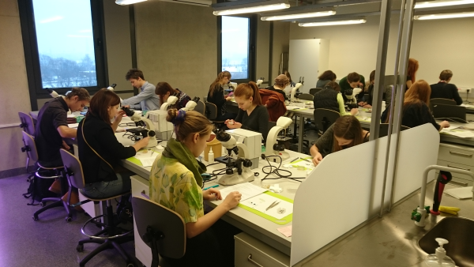
Forms of study process
Chosen by academic staff
Lectures
Laboratory works
Practical works (field works for science students)
Seminars
Practice
Colloquia
Notes:
Academic staff is rather autonomous in choice of forms of study process and there is always a possibility to apply such forms as most relevant for acquisition of the defined learning outcomes.

Slide 101
Preparing a new study course
Need for a new study course in the framework of study programme
A new study course application (form completed by academic staff – course developer/s)
Notes:
But the process is regulated in detail from beginning to end, and to start a new course one prove there is a need for it and a detailed application form has to be submitted .

Slide 102
Preparing a new study course
Study course application form includes the following information:
Course title
Course code (generated by LUIS)
Credit points
ECTS credit points
Total contact hours
Number of lectures
Notes:
The application form contains formal data about the course such as the title and the size of the course.

Slide 103
Preparing a new study course
Study course application form includes the following information(2):
Number of hours for seminars and practical assignments
Independent work
Date of course confirmation
Responsible Unit
Course developers
Replaced course
Course abstract
Study course plan (topics, form [L,S,LD,PD], hours)
Notes:
Also the data on the proportions of specific study forms such as seminars and practical placements, and a short description showing its contents.

Slide 104
Preparing a new study course
Study course application form includes the following information (3):
Learning outcomes
Requirements for awarding credit points
Compulsory reading
Further reading
Periodicals and other sources
Date of study course update (generated by LUIS)
Date of the next study course update (generated by LUIS)
Study course developer/s (author/s)
Notes:
The course application contains info about specific learning outcomes (out of the general list given in the study programme, requirements to the student along with information on resources the students wiil use.

Slide 105
Preparing a new study course
Study course application reviewing by the Branch Council of Study Programmes (academic staff, students and representative of employers are included)
Accepting the study course form by the Board of the faculty responsible for the implementation of the study course
Electronically saving in the LUIS and the conformity assessment by LUIS
Notes:
When the application has been completed it is considered by the Council of the study programmes of the branch of studies, then by the Faculty Board, and then input in the information system.

Slide 106
List of study courses prepared by the author
Notes:
If the course has been accepted, the autor(-s) have to also develop e-course for autonomuous reading. The list of respective e-courses is placed in the internet pages.

Slide 107
Preparing a new study course
Acceptance of the study course form by Study Department, UL
Study course activation in the LUIS by the person of academic staff responsible for the science branch
Entering the supporting information in the MOODLE* by the academic staff.
* A robust open-source learning platfrom (moodle.org) used by University of Latvia
Notes:
Here you can see the formal sequence of the steps to make the course available.

Slide 108
Preparing a new study course
Running the study course (no. of semesters)
Evaluation of students’ knowledge, skills and competence – examination (including examinations during the study course)
Notes:
When the course has been implemented it is following the defined character, and provide the students an opportunity to attain the defined learning outcomes. These learning outcomes have to also be reflected in the forms and contents of the assessment of students.

Slide 109
Preparing a new study course
As the list of learning outcomes is defined in the course description, the academic staff on the basis of results of exams is able to determine whether the outcomes are achieved. In addition, the learning outcomes are evaluated independently in academic seminars organized by faculties.
Notes:
The learning outcomes are also discussed with colleagues in seminars, and their presence in studies and assessments can be questioned and evaluated by external evaluators.

Slide 110
Forms of student assessment
Examination during the study course
Test
Unassisted study work (studying textbooks and journals, working in libraries etc.)
Practical work
Laboratory work
Report
Presentation
Other...
Notes:
To best find out whether particular learning outcomes ahve been achieved, a number of available assessment types can be exploited. E.g., individual reports will show alos some general skills such as ability to analyze data fom literature; presentation of particular work will enable study-mates to analyze and criticize the student’s work. Practical work will enable the staff to evaluate the student’s ability to worlk individually or in team or be a team-leader.

Slide 111
Forms of student assessment
Exams:
Final Examination
Written exam
Oral exam
Combined
Notes:
For basic courses usually written exams are organized, and the result is assessed normally by more than one person. Graduation exam in most cases contains a public presentation of thesis, and the assessment is done by the collegiate body, in which the supervisor has only an advisory role. These nicities are establishet to reduce to the minimum possibilty of subjective treatment of students.

Slide 112
Forms of student assessment
In the UL study course assessment consists of:
total score of examinations during the study course - not less than 50% of the total course rating
Final exam rating - not less than 10% of the rate of the total course rating. Participation in the exam is a requirement in order to obtain a total score for the course.
Notes:
For the assessment forms there are certain predifined weights. In this way the assessment is based on cummulative data to reduce the possibility of random chance (luck or misfortune).

Slide 113
Study support for students
MOODLE is providing students with the necessary information for the study process online – study course content, texts, lecture presentations, description and forms of laboratory works, questions for self control etc.). During the study process discussion (chat) groups can be developed.
Responsibility of academic staff for updates of this information!!!
Notes:
Some more about the student support that has been menioned in the previous parts of our presentation

Slide 114
Study support for students

Slide 115
Study support for students
Academic Library UL
Online study courses (for registered teachers and students)
UL provides free software during the study time: Microsoft Office 365, Wolfram Mathematica, SPSS, Gaussian, Autodesk

Slide 116
Design and building of the assessment book

Slide 117
The Feedback
Evaluation of the study course quality by students
Online questionnaire for study courses and study programmes
Notes:
Some repetition on participation of students in evaluation of quality of courses

Slide 118
The Feedback
Content of questionnaire for study courses
Number of registrered students: X, (1 (absolutely do not agree)...7 (absolutely agree)
Course contents corresponded to the course description
Course contents did not duplicate other courses
Lecturer presented course topics clearly
Lecturer’s teaching methods contributed to the study course acquisition
Available e-course material helped to acquire study course, (if there was no e-course, it should be answered “Do not know, I cannot say “)
Notes:
Here you can see in detail what information one can gain from students’ evaluations designed and organized centrally.

Slide 119
The Feedback
Content of questionnaire for study courses
Number of registered students
Tests during the semester of the course contributed to the acquisition of it
The teacher was available for consultations
During the course I attained learning outcomes recorded in the course description
It would be great to listen another study course of this lecturer
Lecturer's explanation of the test results is good enough
TOTAL
Notes:
But, apart from that, questionnaires and opinion polls can also be organized by the faculty or by students’ self-government bodies

Slide 120
The Feedback
Self-evaluation of the academic staff – individual studies and analysis of results provided by questionnaire, analysis of mistakes made.
Changes in the content and methods used in running the study course.
Notes:
Based on evaluations organized centrally or at grass-root level the lecturer can analyze the success of his course and the forms of studies and assessments to work for improvement of the course.

Slide 121
The Feedback
Analysis of results provided by questionnaires during academic seminars of the Faculty.
Acceptance of the course changes by Council of Study programmes and Board of the Faculty.
Rise of the study course quality as a result of collaboration of students and academic staff.
Notes:
If the changes are indicated , there is the procedure for enacting them.
This information can also be used for evaluation of staff for the purpose of suggesting the necessary type of self-education for the lecturer or – in certain cases – for voting against his/her reelection in the academic position.

Slide 122
The Feedback
The above mentioned process is defined by 31.08.2010 UL Instruction No. 1/219 «Requirements for the study course preparation and updating», including 21.01.2011. Annex No. 1 and Annex No 2.
Notes:
This is the regulating paper covering the above process.

Slide 123
Learning outcomes (reference guide)
Notes:
Here I can provide some reference material on learning outcomes. It has been taken from Eurpean sources and is used by our institution as needed, and it can also be suggested to our partners if they decide to work for implementation of the LO un their practice.

Slide 124
Learning outcomes
Knowledge (In the context of EQF*, knowledge is described as theoretical and/or factual).
Skills - cognitive (involving the use of logical, intuitive and creative thinking), and practical (involving manual dexterity and the use of methods, materials, tools and instruments)
Competencies (competence is described in terms of responsibility and autonomy).
* https://ec.europa.eu/ploteus/content/descriptors-page
Notes:
I will not comment on it, only show you what it is about

Slide 125
Learning outcomes
Knowledge (8 levels)
Level 1 - Basic general knowledge.
Level 2 – Basic factual knowledge of a field of work or study.
Level 3 - Knowledge of facts, principles, processes and general concepts, in a field of work or study.
Level 4 - Factual and theoretical knowledge in broad contexts within a field of work or study.
Level 5 - Comprehensive, specialized, factual and theoretical knowledge within a field of work or study and an awareness of the boundaries of that knowledge.
Notes:
It consists of knowledge that can be defined, depending on the cycle of studies It will be different for B.,M. or D. Studies in the same study domain.

Slide 126
Learning outcomes
Knowledge (8 levels)
Level 6 - Advanced knowledge of a field of work or study, involving a critical understanding of theories and principles.
Level 7 - Highly specialized knowledge, some of which is at the forefront of knowledge in a field of work or study, as the basis for original thinking and/or research. Critical awareness of knowledge issues in a field and at the interface between different fields.
Level 8 - Knowledge at the most advanced frontier of a field of work or study and at the interface between fields.

Slide 127
Learning outcomes
Skills (8 levels)
Level 1 - Basic skills required to carry out simple tasks.
Level 2 - Basic cognitive and practical skills required to use relevant information in order to carry out tasks and to solve routine problems using simple rules and tools.
Level 3 - A range of cognitive and practical skills required to accomplish tasks and solve problems by selecting and applying basic methods, tools, materials and information.
Level 4 - A range of cognitive and practical skills required to generate solutions to specific problems in a field of work or study.
Notes:
The same about skills

Slide 128
Learning outcomes
Skills (8 levels)
Level 5 - A comprehensive range of cognitive and practical skills required to develop creative solutions to abstract problems.
Level 6 - Advanced skills, demonstrating mastery and innovation, required to solve complex and unpredictable problems in a specialized field of work or study.
Level 7 - Specialized problem-solving skills required in research and/or innovation in order to develop new knowledge and procedures and to integrate knowledge from different fields.

Slide 129
Learning outcomes
Skills (8 levels)
Level 8 - The most advanced and specialized skills and techniques, including synthesis and evaluation, required to solve critical problems in research and/or innovation and to extend and redefine existing knowledge or professional practice.

Slide 130
Learning outcomes
Competencies (8 levels)
Level 1 - Work or study under direct supervision in a structured context.
Level 2 - Work or study under supervision with some autonomy.
Level 3 - Take responsibility for completion of tasks in work or study; adapt own behaviour to circumstances in solving problems.
Level 4 - Exercise self-management within the guidelines of work or study contexts that are usually predictable, but are subject to change; supervise the routine work of others, taking some responsibility for the evaluation and improvement of work or study activities.
Notes:
And about competencies (naturally, the higher study cycle, the more advanced knowledge, skills and competencies need to be attained.

Slide 131
Learning outcomes
Competencies (8 levels)
Level 5 - Exercise management and supervision in contexts of work or study activities where there is unpredictable change; review and develop performance of self and others.
Level 6 - Manage complex technical or professional activities or projects, taking responsibility for decision-making in unpredictable work or study contexts; take responsibility for managing professional development of individuals and groups.

Slide 132
Learning outcomes
Competencies (8 levels)
Level 7 - Manage and transform work or study contexts that are complex, unpredictable and require new strategic approaches; take responsibility for contributing to professional knowledge and practice and/or for reviewing the strategic performance of teams.
Level 8 - Demonstrate substantial authority, innovation, autonomy, scholarly and professional integrity and sustained commitment to the development of new ideas or processes at the forefront of work or study contexts including research.
Notes:
These formulations are very useful to generate descriptors for the NQF and further on for particular SP. Particular SP, however has to be developed folowing the national standards. In our NQF the descriptors have been developed in 2005-2006 and they are in force since 2011.

Slide 133
Acknowledgement and disclaimer
This project has been funded with support from the European Commission within Erasmus+ programme.
This presentation reflects the views only of the authors, and the EC cannot be held responsible for any use which may be made of the information contained therein.
Notes:
These are compulsory statements for EU-funded projects one has to include in publications funded from EC

Slide 134
Thank you for your attention!
Paldies! Pақмет сізге! Rahmat!

